Slide 1
Econ 642: Week 2
Economic Growth

Slide 2
Announcements
Discussion 2 is available
Problem Set 1 will be available and due 12/17/24
Presentation Set 1 next week (12/10/24)
Please review ELMS to make sure if you are scheduled
Please send me a copy of the slides by the weekend, so I can give feedback
Allocate 15 minutes (which is about 10 slides)
Include a discussion on Introduction/Research Question, Literature Review, Data, Methods, Results, and your feedback/critiques
I prefer PowerPoint, but if you want to use another source just run it by me
Please send me a copy by Saturday, so I can review and give feedback.

Slide 3
Economic Growth Overview
Economic Growth
The Very Long Run
Kaldor Facts
Growth Across Countries
Solow Growth Model
Model Inputs
Mechanics
The Golden Rule
Markets
Technological Progress

Slide 4
Economic Growth
Kurlat Chapter 3

Slide 5
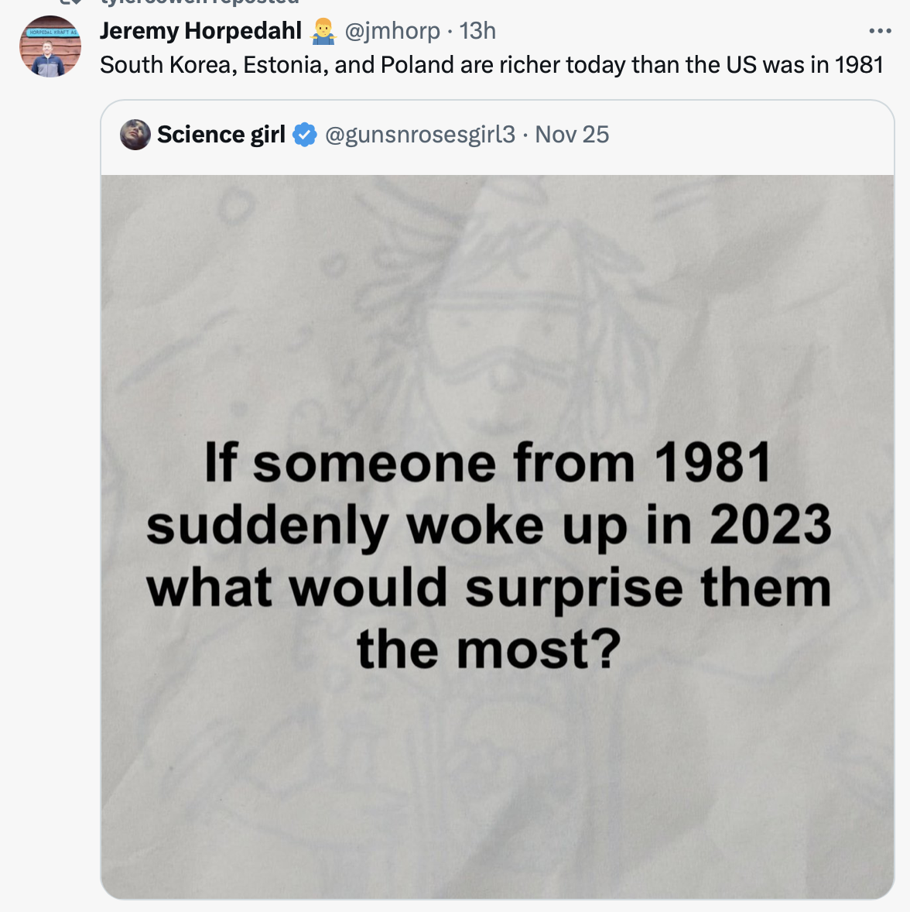

Slide 6
Economic Growth in the Very Long Run
It is difficult to measure economic growth going back hundreds of years
No statistical agencies for proper national accounting
Lack quality data on output – a lot of guess work
Maddison (2001)
Piece meal data from various sources
Average height, total number of livestock, crop yields or total output of very specific industries, such as iron
Minimum level of subsistence – below this people starve
This is about 400 dollars a year at current prices

Slide 7
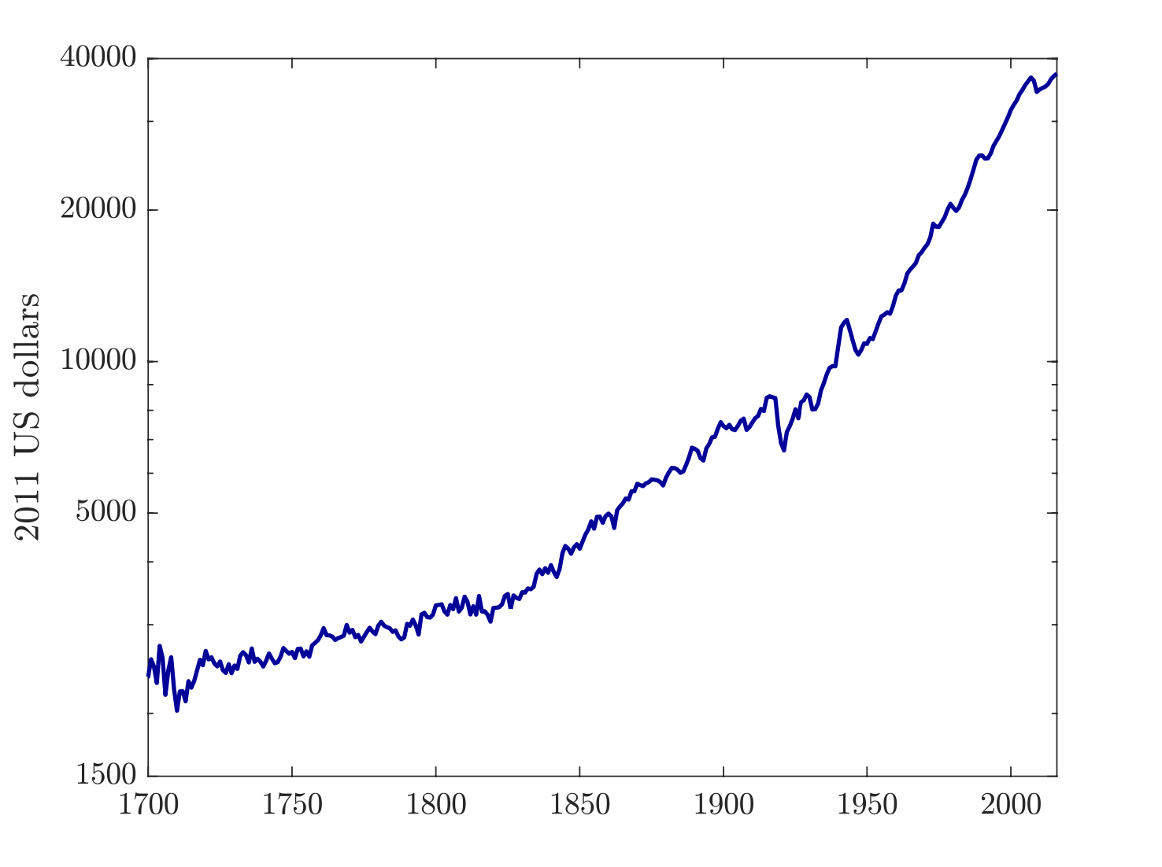
Very Long Run
GDP per capita in UK in the very long run
Even before Industrial Revolution, UK had a GDP per capita above the subsistence level
Industrial Revolution in the 19th Century and production shifts from agriculture to industry

Slide 8
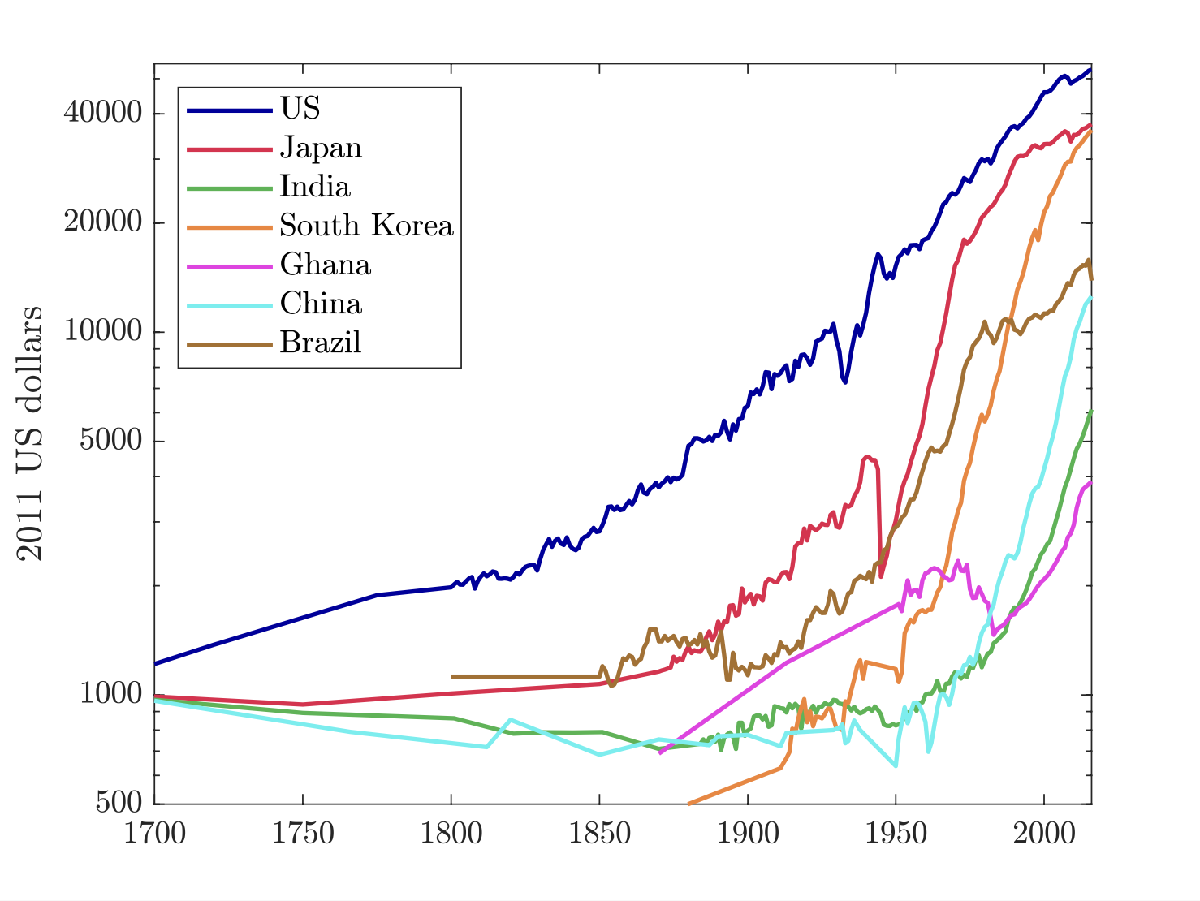
Very Long Run
Other countries have gone through similar shifts
These countries start not much above the subsistence level and at different dates they began to grow

Slide 9
The Kaldor Facts
Kaldor (1957) summarized empirical observations from economic growth in advanced economies
Basis for success of the neoclassical growth model
Emphasis on physical capital accumulation
Kaldor Observations or Kaldor Facts
1) The rate of growth of GDP per capita is constant
2) The ratio of total capital stock to GDP is constant
3) Share of labor and capital income in GDP are constant
4) The average rate of return on capital is constant

Slide 10
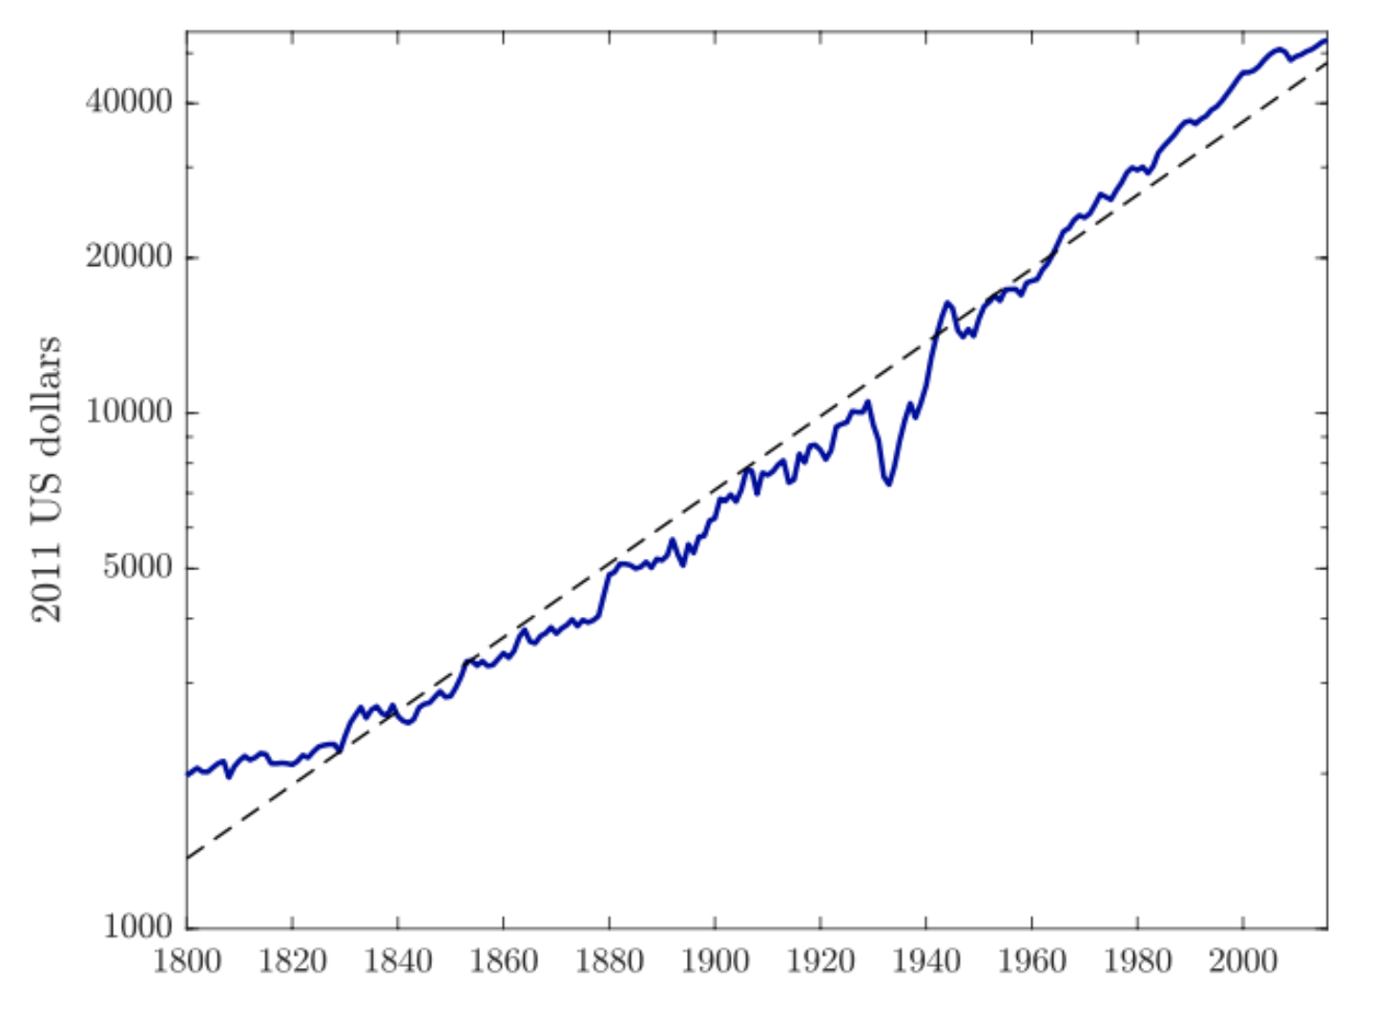
Kaldor Facts
1) The rate of growth of GDP per capita is constant
Note: the scale is in natural log
About 1.5% growth compounded over 1800 to 2016 results in an increase of GDP per capita of 27 times higher

Slide 11
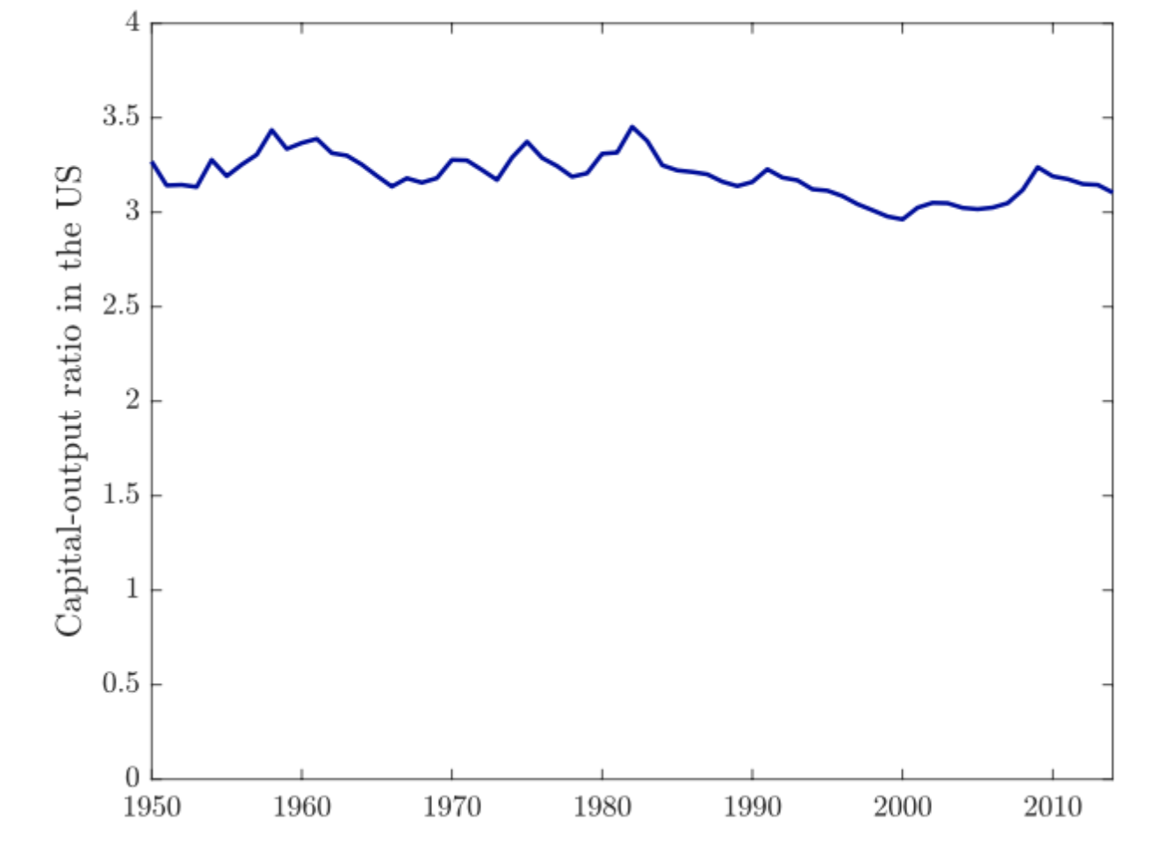
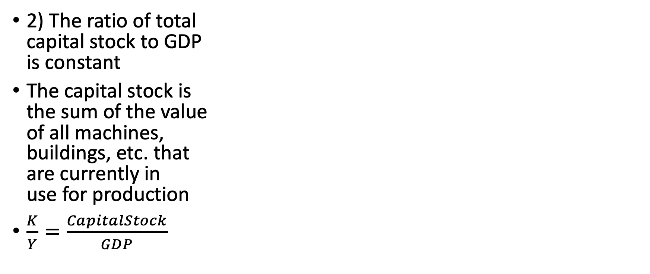
Kaldor Facts
2) The ratio of total capital stock to GDP is constant
The capital stock is the sum of the value of all machines, buildings, etc. that are currently in use for production
$\frac{K}{Y}=\frac{CapitalStock}{GDP}$

Slide 12
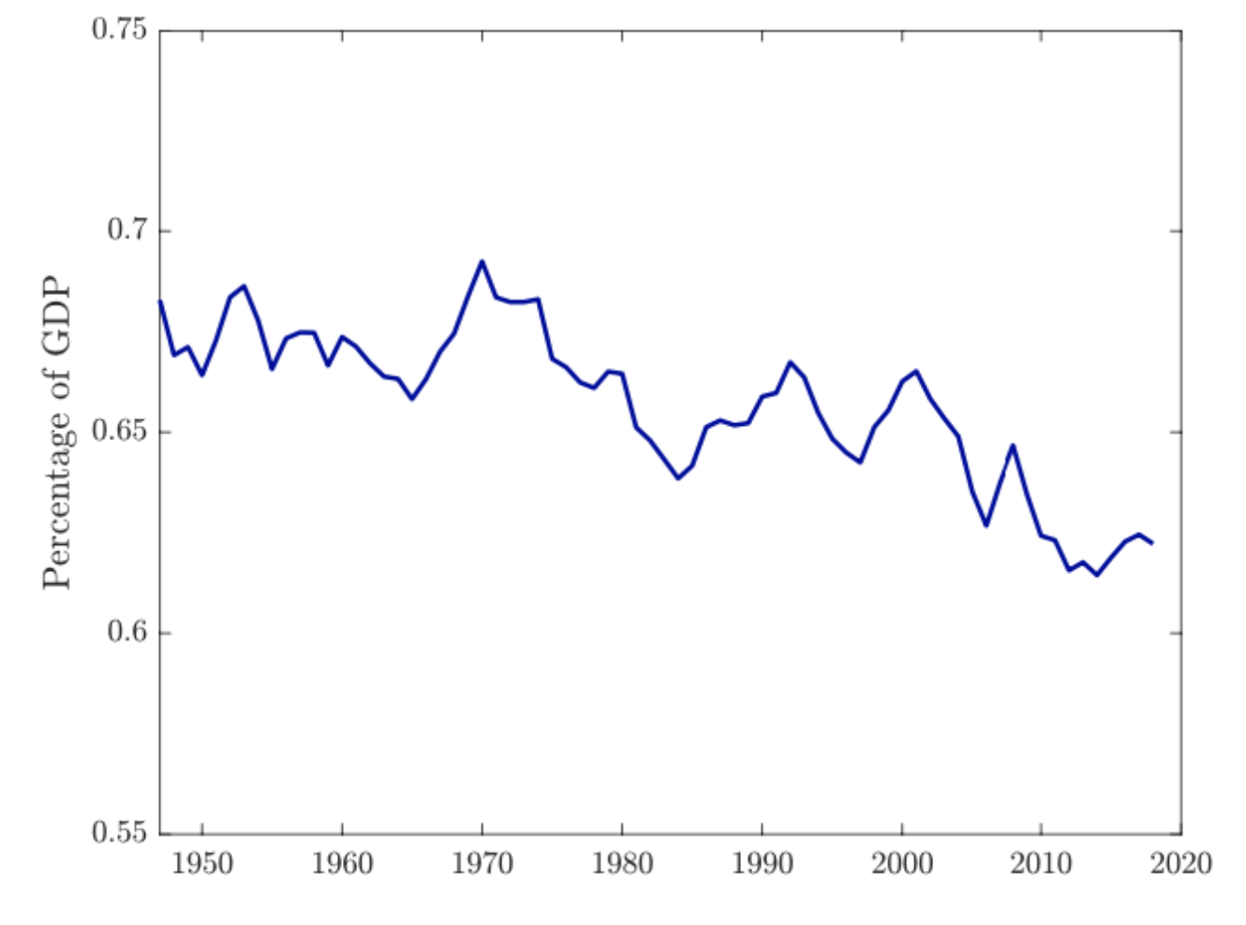
Kaldor Facts
3) Share of labor and capital income in GDP are constant
The share of all income earned by wages
The share of capital income: profits, rent
Sole proprietor is split between wages and capital income
The share of labor income has fallen by 3 percentage points

Slide 13
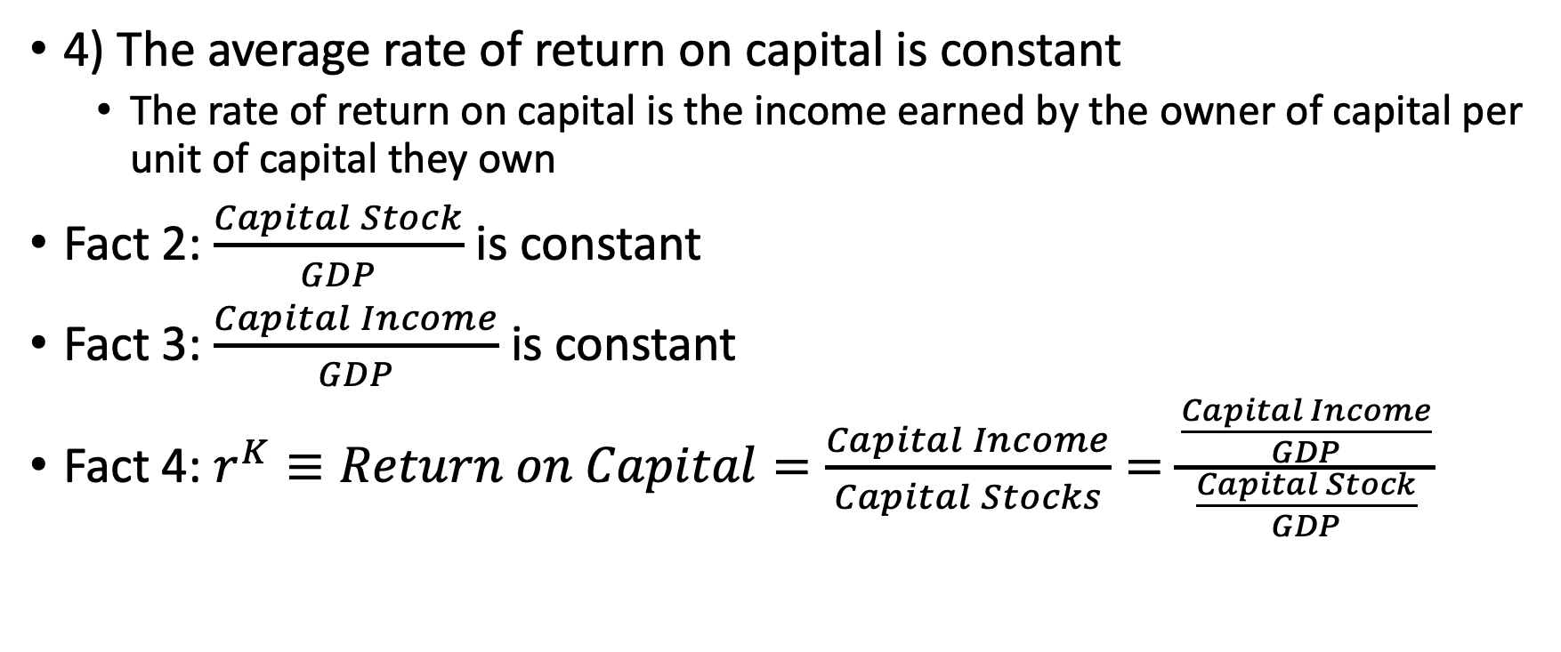
Kaldor Facts
4) The average rate of return on capital is constant
The rate of return on capital is the income earned by the owner of capital per unit of capital they own
Fact 2: $\frac{Capital Stock}{GDP}$ is constant
Fact 3: $\frac{Capital Income}{GDP}$ is constant
Fact 4: $r^{K}≡Return on Capital=\frac{Capital Income}{Capital Stocks}=\frac{\frac{Capital Income}{GDP}}{\frac{Capital Stock}{GDP}}$

Slide 14
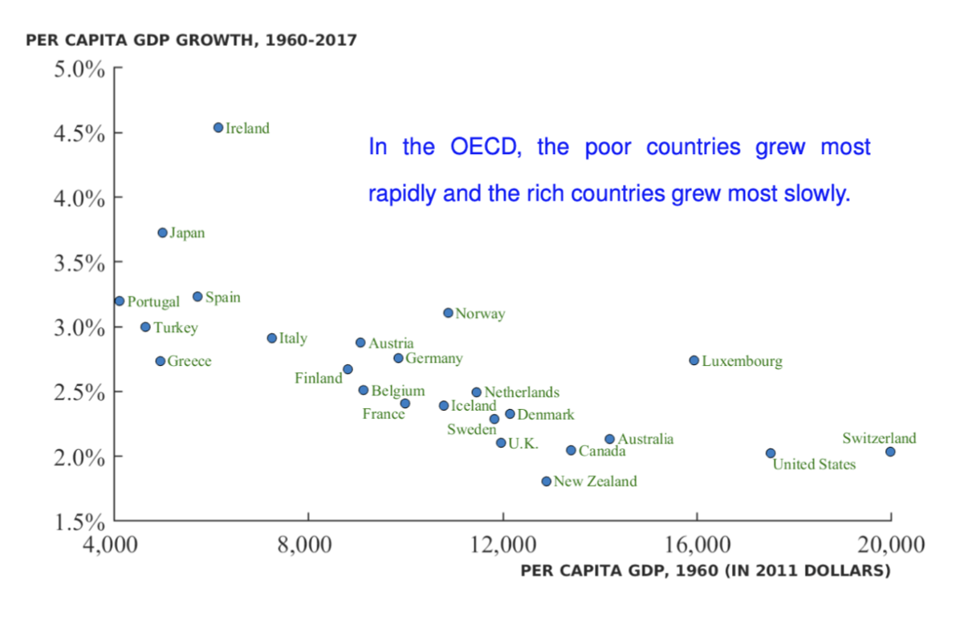
Growth Rates Across Countries
Advanced economies usually have lower growth rates and growth rates close to one another

Slide 15
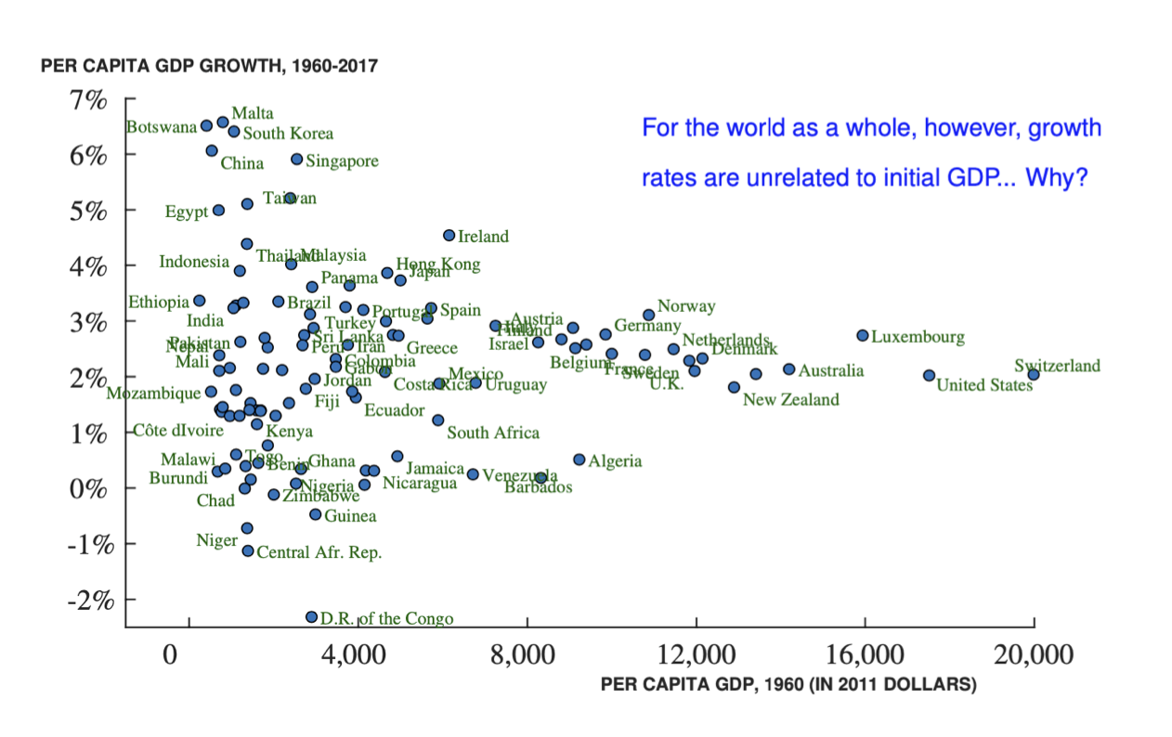
Growth Rates Across Countries
Initially poor countries have a lot of variation in growth
South Korea and Botswana have high growth but Congo and Madagascar have low growth

Slide 16
Economic Growth
Before 1960, South Korea and Philippines were similar
Between 1960-2017: there was a divergence of economic growth
Country | South Korea | Philippines
GDP per capita (1960) | $1,500 | $2,300
Population (in millions) | 25 | 28
Main Sectors | Industry/Agriculture | Industry/Agriculture
College Enrollment | 5% | 13%
Country | South Korea | Philippines
Real GDP growth | 6.5% | 2.5%
GDP per capita (2017) | $36,000 | $7,500

Slide 17
Solow Growth Model
Kurlat Chapter 4: Economic Growth in the Very Long Run

Slide 18
The Solow Growth Model
Model Inputs
Mechanisms of the Model
The Golden Rule
Markets
Technological Progress

Slide 19
Solow Growth Model: Model Inputs

Slide 20
Model Inputs
Solow (1956) proposed a simple model which can help up think about economic growth in the very long run
Model Inputs Include
The Production Function
Population and the Supply of Labor
Consumption and Investment
Depreciation and Capital Accumulation
End Result
In the very long run, the economy converges on the steady state and GDP per capita and capital per worker will remain constant
The growth of GDP per capita will slow down to zero in the very long run

Slide 21
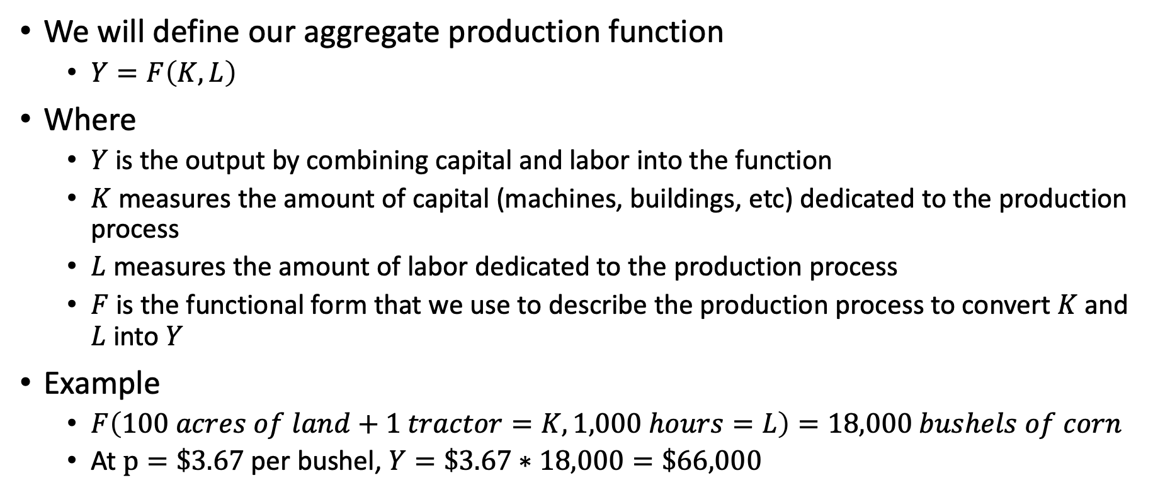
Model Inputs: Production Function
We will define our aggregate production function
$Y=F\left(K,L\right)$
Where
$Y$ is the output by combining capital and labor into the function
$K$ measures the amount of capital (machines, buildings, etc) dedicated to the production process
$L$ measures the amount of labor dedicated to the production process
$F$ is the functional form that we use to describe the production process to convert $K$ and $L$ into $Y$
Example
$F\left(100 acres of land+1 tractor=K, 1,000 hours=L\right)=18,000 bushels of corn$
At $p=\$3.67$per bushel, $Y=\$3.67∗18,000=\$66,000$

Slide 22
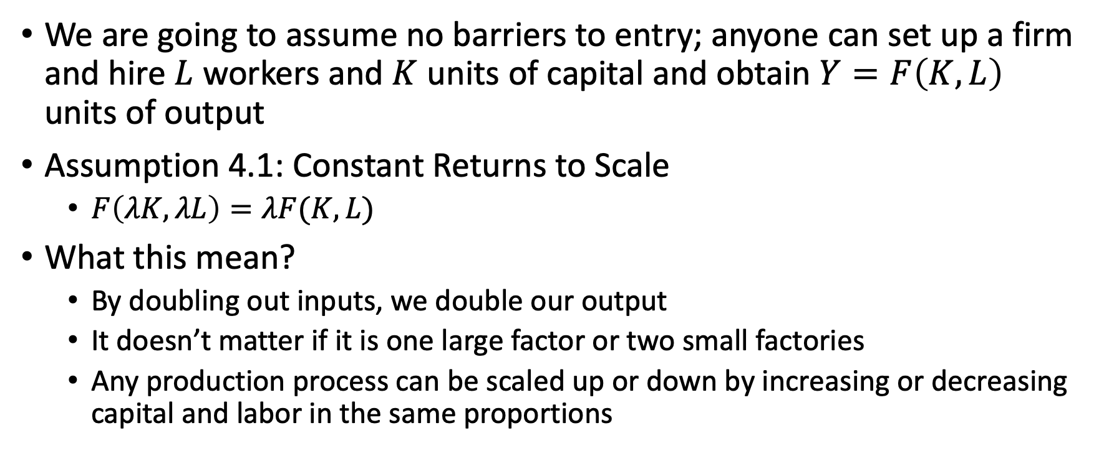
Model Input: Production Function
We are going to assume no barriers to entry; anyone can set up a firm and hire $L$ workers and $K$ units of capital and obtain $Y=F\left(K,L\right)$ units of output
Assumption 4.1: Constant Returns to Scale
$F\left(λK,λL\right)=λF(K,L)$
What this mean?
By doubling out inputs, we double our output
It doesn’t matter if it is one large factor or two small factories
Any production process can be scaled up or down by increasing or decreasing capital and labor in the same proportions

Slide 23
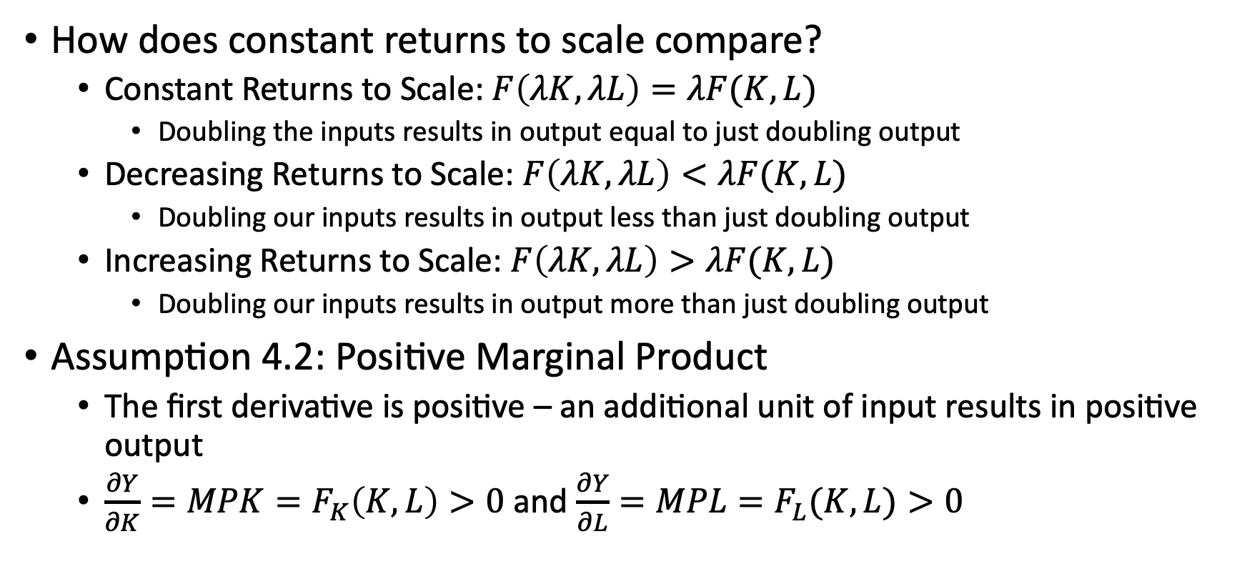
Model Input: Production Function
How does constant returns to scale compare?
Constant Returns to Scale: $F\left(λK,λL\right)=λF(K,L)$
Doubling the inputs results in output equal to just doubling output
Decreasing Returns to Scale: $F\left(λK,λL\right)<λF(K,L)$
Doubling our inputs results in output less than just doubling output
Increasing Returns to Scale: $F\left(λK,λL\right)>λF(K,L)$
Doubling our inputs results in output more than just doubling output
Assumption 4.2: Positive Marginal Product
The first derivative is positive – an additional unit of input results in positive output
$\frac{∂Y}{∂K}=MPK=F_{K}\left(K,L\right)>0$ and $\frac{∂Y}{∂L}=MPL=F_{L}(K,L)>0$

Slide 24
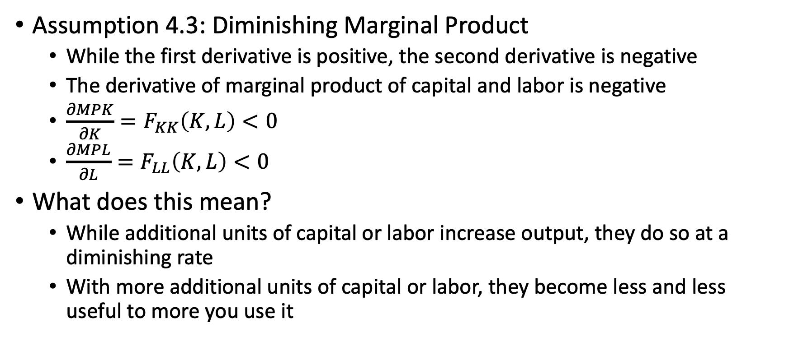
Model Input: Production Function
Assumption 4.3: Diminishing Marginal Product
While the first derivative is positive, the second derivative is negative
The derivative of marginal product of capital and labor is negative
$\frac{∂MPK}{∂K}=F_{KK}\left(K,L\right)<0$
$\frac{∂MPL}{∂L}=F_{LL}\left(K,L\right)<0$
What does this mean?
While additional units of capital or labor increase output, they do so at a diminishing rate
With more additional units of capital or labor, they become less and less useful to more you use it

Slide 25
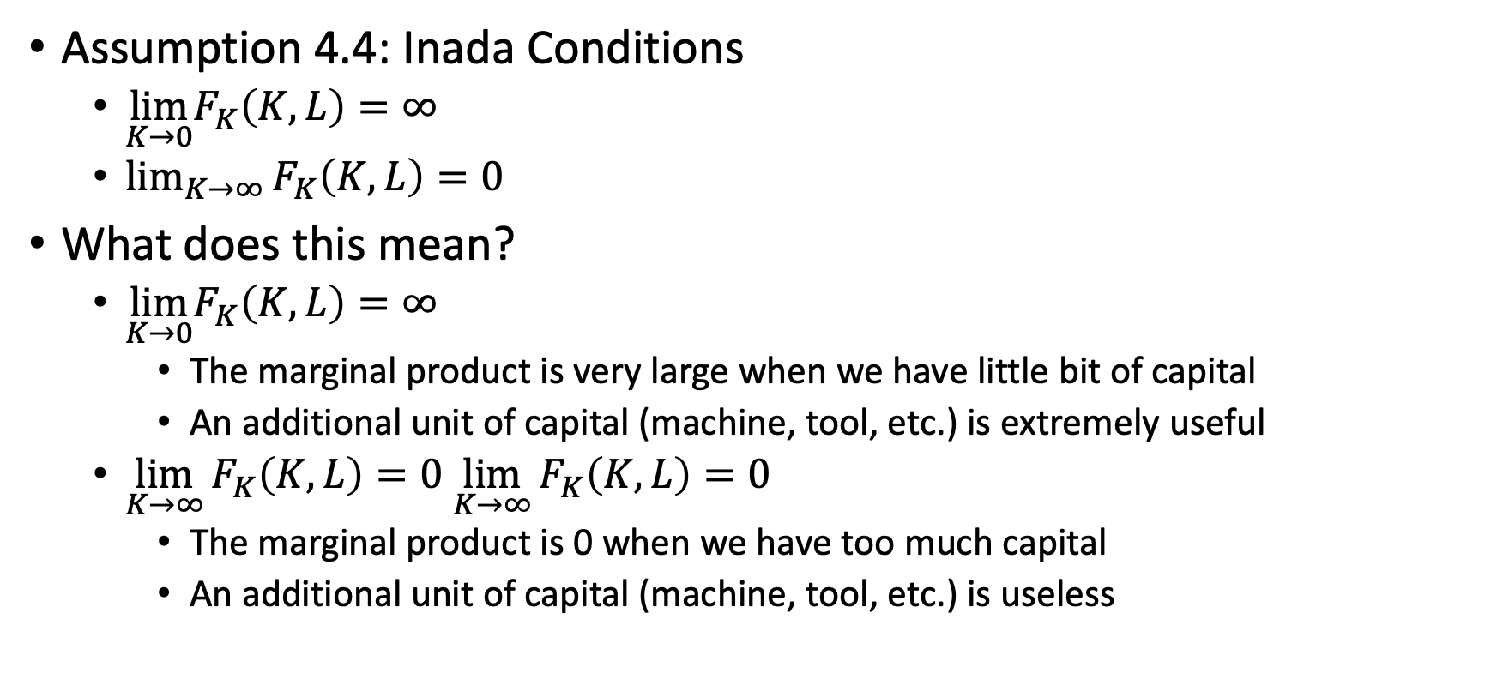
Model Input: Production Function
Assumption 4.4: Inada Conditions
$\lim_{K→0}F_{K}\left(K,L\right)=∞$
$\lim_{K→∞}{F_{K}\left(K,L\right)=0}$
What does this mean?
$\lim_{K→0}F_{K}\left(K,L\right)=∞$
The marginal product is very large when we have little bit of capital
An additional unit of capital (machine, tool, etc.) is extremely useful
$\lim_{K→∞}{F_{K}\left(K,L\right)=0}$ $\lim_{K→∞}{F_{K}\left(K,L\right)=0}$
The marginal product is 0 when we have too much capital
An additional unit of capital (machine, tool, etc.) is useless

Slide 26
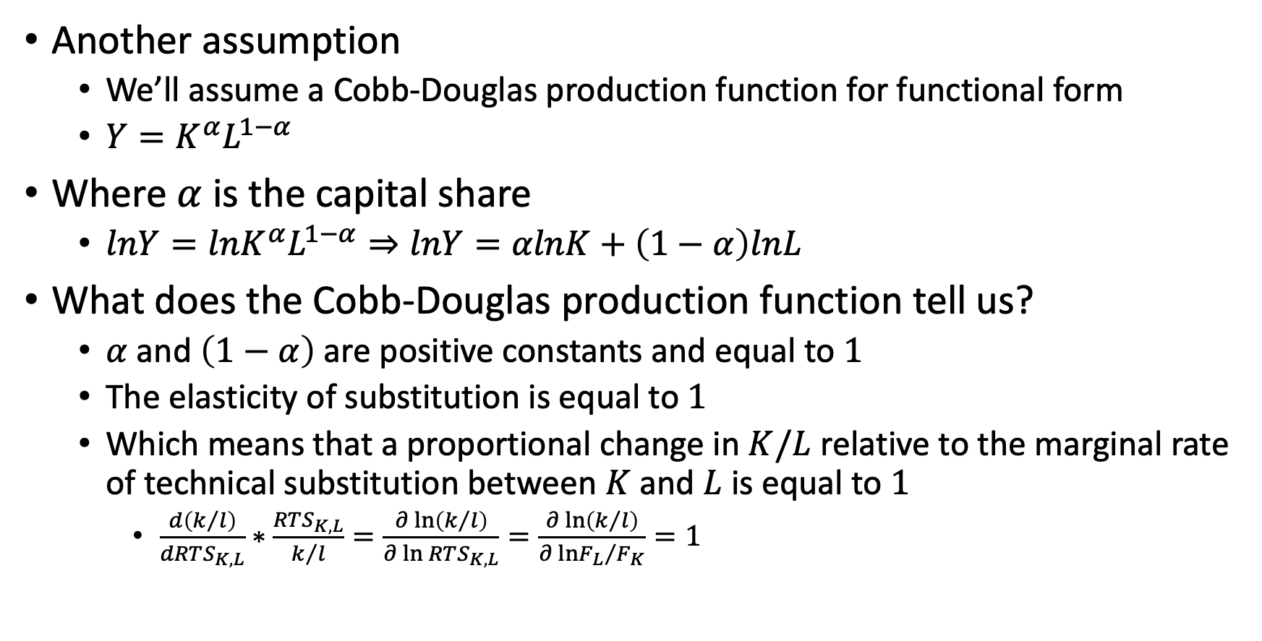
Model Input: Production Function
Another assumption
We’ll assume a Cobb-Douglas production function for functional form
$Y=K^{α}L^{1−α}$
Where $α$ is the capital share
$lnY=lnK^{α}L^{1−α}⇒lnY=αlnK+\left(1−α\right)lnL$
What does the Cobb-Douglas production function tell us?
$α$ and $\left(1−α\right)$ are positive constants and equal to $1$
The elasticity of substitution is equal to $1$
Which means that a proportional change in $K/L$ relative to the marginal rate of technical substitution between $K$ and $L$ is equal to $1$
$\frac{d\left(k/l\right)}{dRTS_{K,L}}∗\frac{RTS_{K,L}}{k/l}=\frac{∂\ln\left(k/l\right)}{∂\ln{RTS_{K,L}}}=\frac{∂\ln\left(k/l\right)}{∂\ln{{F_{L}}/{F_{K}}}}=1$

Slide 27
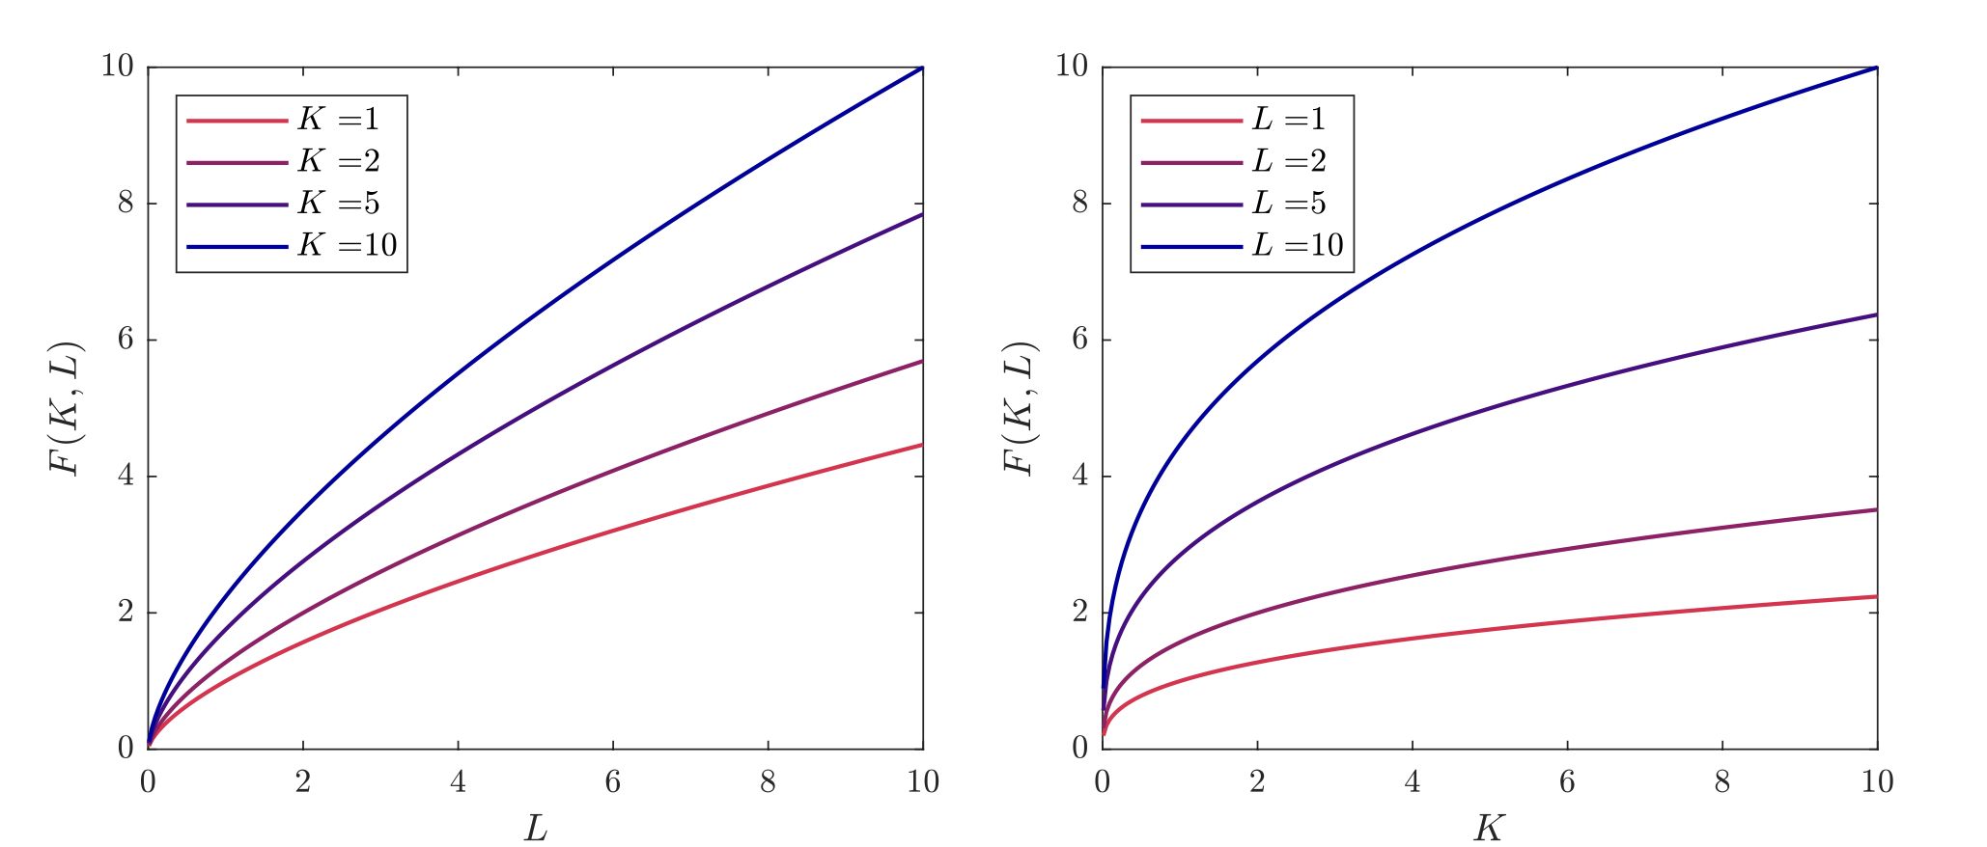
Model Inputs: Cobb Douglas
The Cobb-Douglas Production Function when $α=0.35$

Slide 28
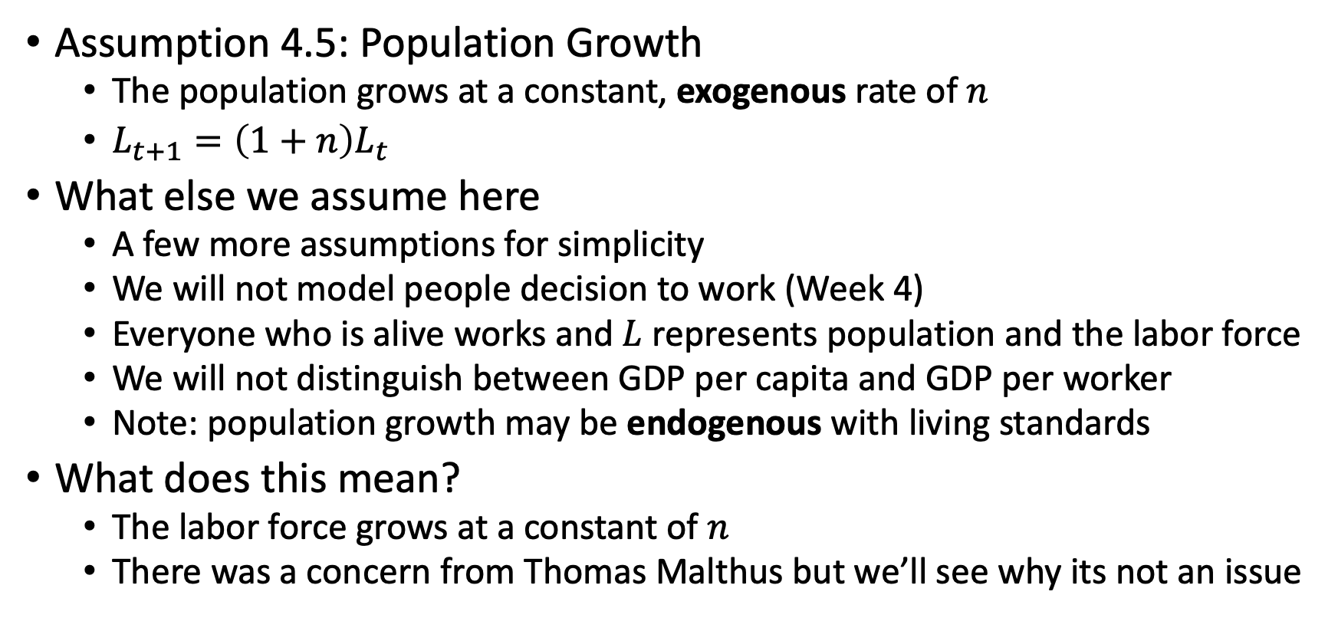
Model Inputs: Population and Labor Supply
Assumption 4.5: Population Growth
The population grows at a constant, exogenous rate of $n$
$L_{t+1}=\left(1+n\right)L_{t}$
What else we assume here
A few more assumptions for simplicity
We will not model people decision to work (Week 4)
Everyone who is alive works and $L$ represents population and the labor force
We will not distinguish between GDP per capita and GDP per worker
Note: population growth may be endogenous with living standards
What does this mean?
The labor force grows at a constant of $n$
There was a concern from Thomas Malthus but we’ll see why its not an issue

Slide 29
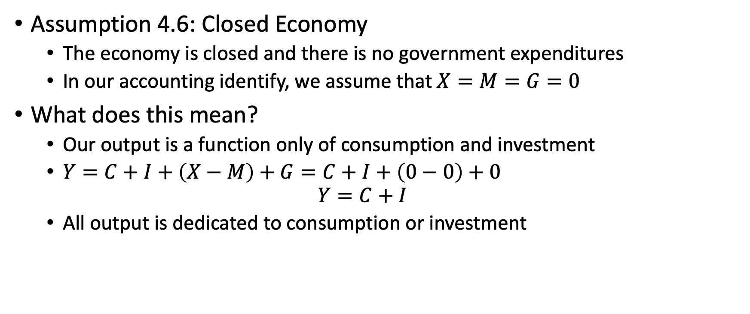
Model Inputs: Consumption and Investment
Assumption 4.6: Closed Economy
The economy is closed and there is no government expenditures
In our accounting identify, we assume that $X=M=G=0$
What does this mean?
Our output is a function only of consumption and investment
$Y=C+I+\left(X−M\right)+G=C+I+\left(0−0\right)+0$ $Y=C+I$
All output is dedicated to consumption or investment

Slide 30
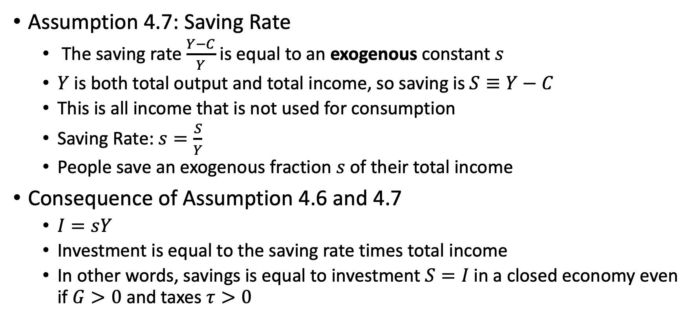
Model Inputs: Consumption and Investment
Assumption 4.7: Saving Rate
The saving rate $\frac{Y−C}{Y}$ is equal to an exogenous constant $s$
$Y$ is both total output and total income, so saving is $S≡Y−C$
This is all income that is not used for consumption
Saving Rate: $s=\frac{S}{Y}$
People save an exogenous fraction $s$ of their total income
Consequence of Assumption 4.6 and 4.7
$I=sY$
Investment is equal to the saving rate times total income
In other words, savings is equal to investment $S=I$ in a closed economy even if $G>0$ and taxes $τ>0$

Slide 31
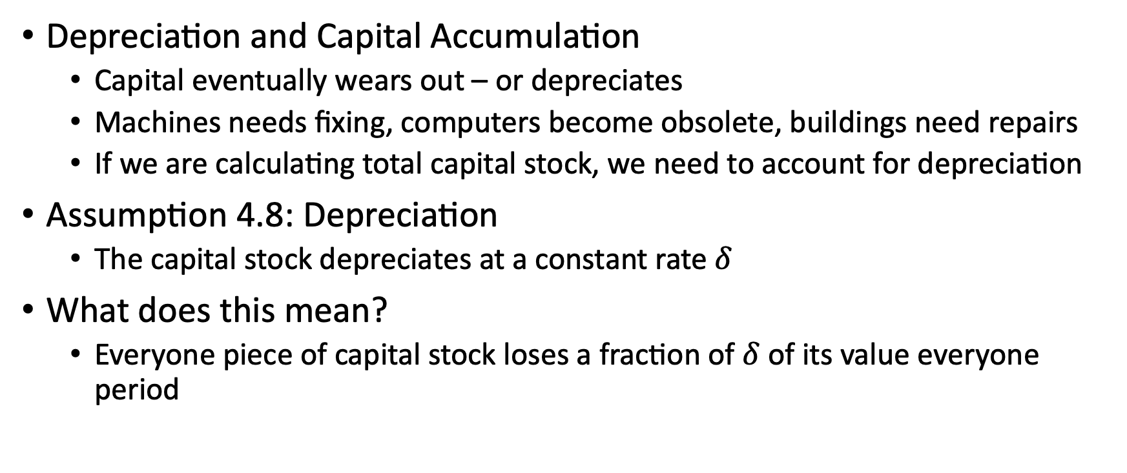
Model Inputs: Depreciation and Capital
Depreciation and Capital Accumulation
Capital eventually wears out – or depreciates
Machines needs fixing, computers become obsolete, buildings need repairs
If we are calculating total capital stock, we need to account for depreciation
Assumption 4.8: Depreciation
The capital stock depreciates at a constant rate $δ$
What does this mean?
Everyone piece of capital stock loses a fraction of $δ$ of its value everyone period

Slide 32
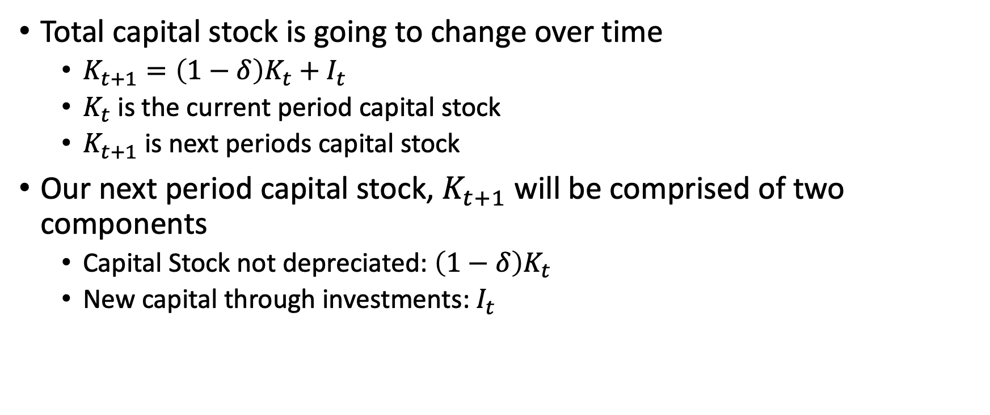
Model Inputs: Depreciation and Capital
Total capital stock is going to change over time
$K_{t+1}=\left(1−δ\right)K_{t}+I_{t}$
$K_{t}$ is the current period capital stock
$K_{t+1}$ is next periods capital stock
Our next period capital stock, $K_{t+1}$ will be comprised of two components
Capital Stock not depreciated: $\left(1−δ\right)K_{t}$
New capital through investments: $I_{t}$

Slide 33
Solow Growth Model: Mechanisms of the Model

Slide 34
Mechanisms of the Model
The mechanisms of the Solow Growth Model consist of
Per Capita Production Function
Dynamics of Capital Per Worker
Growth and Level Effects

Slide 35
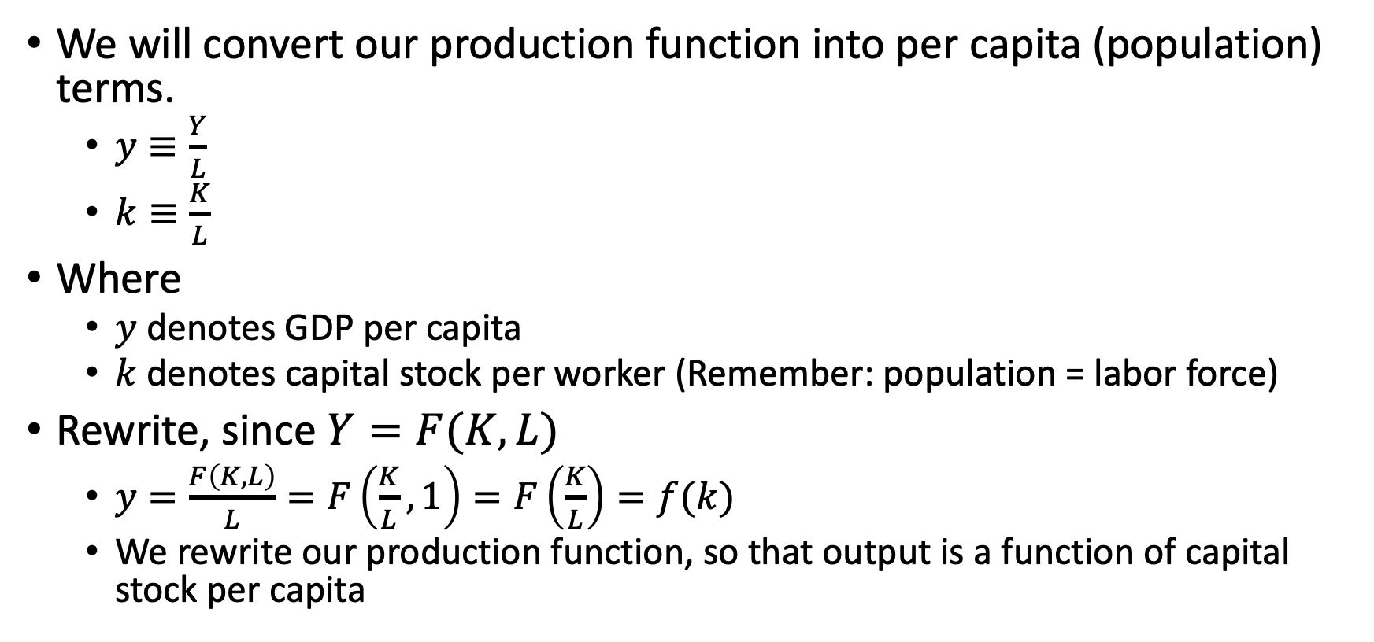
Mechanisms: Per Capita Production Function
We will convert our production function into per capita (population) terms.
$y≡\frac{Y}{L}$
$k≡\frac{K}{L}$
Where
$y$ denotes GDP per capita
$k$ denotes capital stock per worker (Remember: population = labor force)
Rewrite, since $Y=F(K,L)$
$y=\frac{F\left(K,L\right)}{L}=F\left(\frac{K}{L},1\right)=F\left(\frac{K}{L}\right)=f(k)$
We rewrite our production function, so that output is a function of capital stock per capita

Slide 36
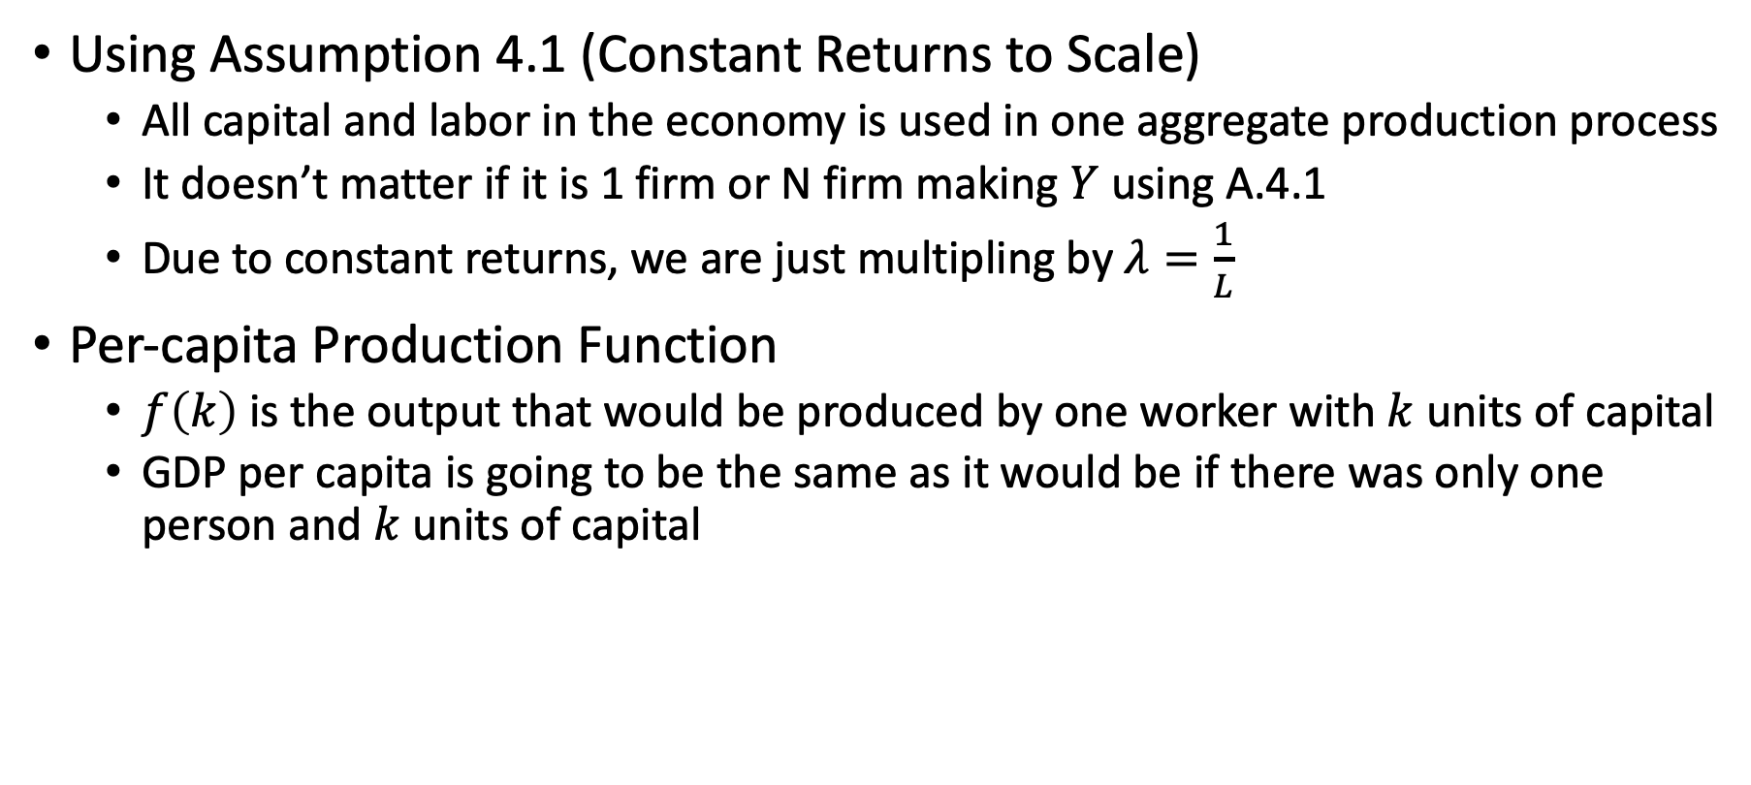
Mechanisms: Per Capita Production Function
Using Assumption 4.1 (Constant Returns to Scale)
All capital and labor in the economy is used in one aggregate production process
It doesn’t matter if it is 1 firm or N firm making $Y$ using A.4.1
Due to constant returns, we are just multipling by $λ=\frac{1}{L}$
Per-capita Production Function
$f\left(k\right)$ is the output that would be produced by one worker with $k$ units of capital
GDP per capita is going to be the same as it would be if there was only one person and $k$ units of capital

Slide 37
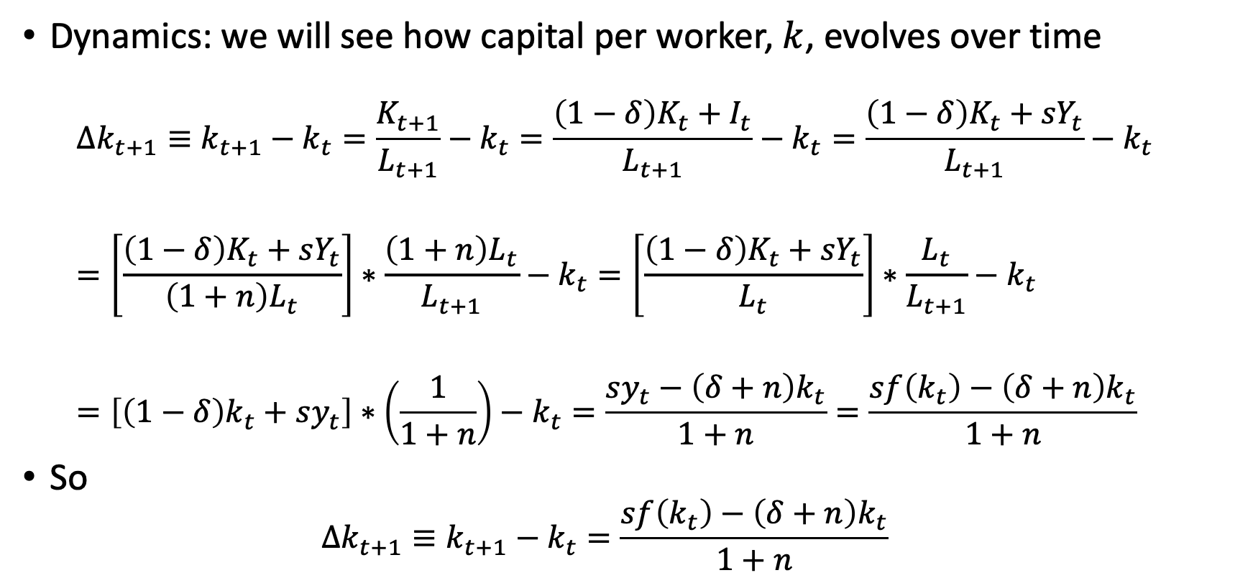
Mechanisms: Dynamics of Capital per Worker
Dynamics: we will see how capital per worker, $k$, evolves over time
$$Δk_{t+1}≡k_{t+1}−k_{t}=\frac{K_{t+1}}{L_{t+1}}−k_{t}=\frac{\left(1−δ\right)K_{t}+I_{t}}{L_{t+1}}−k_{t}=\frac{\left(1−δ\right)K_{t}+{sY}_{t}}{L_{t+1}}−k_{t}$$
$$=\left[\frac{\left(1−δ\right)K_{t}+{sY}_{t}}{\left(1+n\right)L_{t}}\right]∗\frac{\left(1+n\right)L_{t}}{L_{t+1}}−k_{t}=\left[\frac{\left(1−δ\right)K_{t}+{sY}_{t}}{L_{t}}\right]∗\frac{L_{t}}{L_{t+1}}−k_{t}$$
$$=\left[\left(1−δ\right)k_{t}+sy_{t}\right]∗\left(\frac{1}{1+n}\right)−k_{t}=\frac{sy_{t}−\left(δ+n\right)k_{t}}{1+n}=\frac{sf\left(k_{t}\right)−\left(δ+n\right)k_{t}}{1+n}$$
So
$$Δk_{t+1}≡k_{t+1}−k_{t}=\frac{sf\left(k_{t}\right)−\left(δ+n\right)k_{t}}{1+n}$$

Slide 38
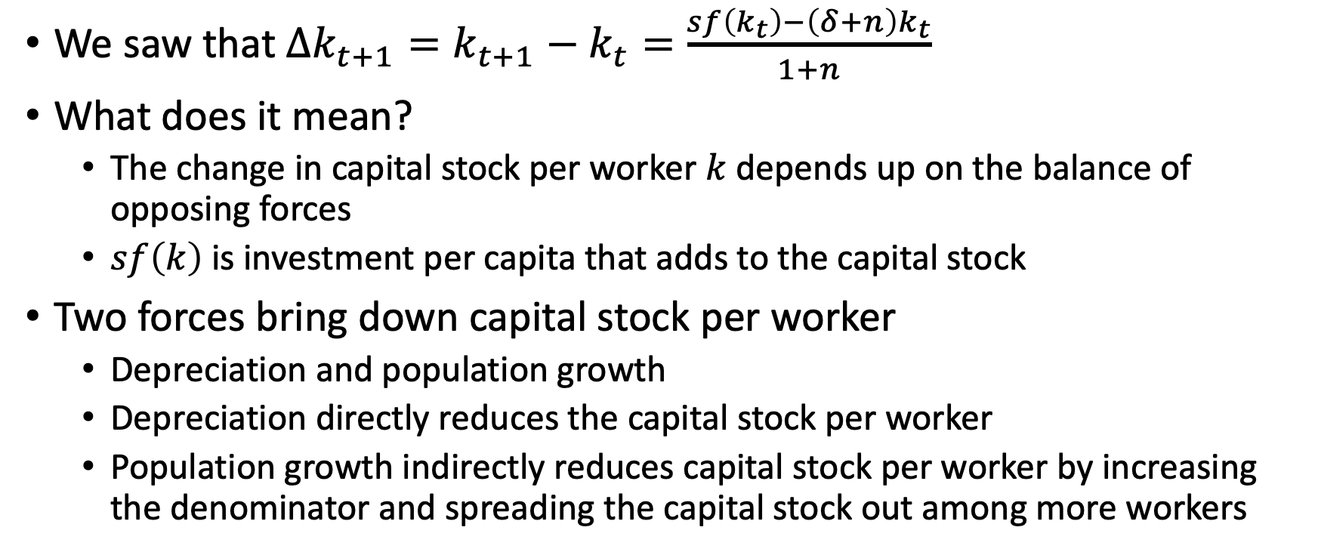
Mechanisms: Dynamics of Capital per Worker
We saw that $Δk_{t+1}=k_{t+1}−k_{t}=\frac{sf\left(k_{t}\right)−\left(δ+n\right)k_{t}}{1+n}$
What does it mean?
The change in capital stock per worker $k$ depends up on the balance of opposing forces
$sf\left(k\right)$ is investment per capita that adds to the capital stock
Two forces bring down capital stock per worker
Depreciation and population growth
Depreciation directly reduces the capital stock per worker
Population growth indirectly reduces capital stock per worker by increasing the denominator and spreading the capital stock out among more workers

Slide 39
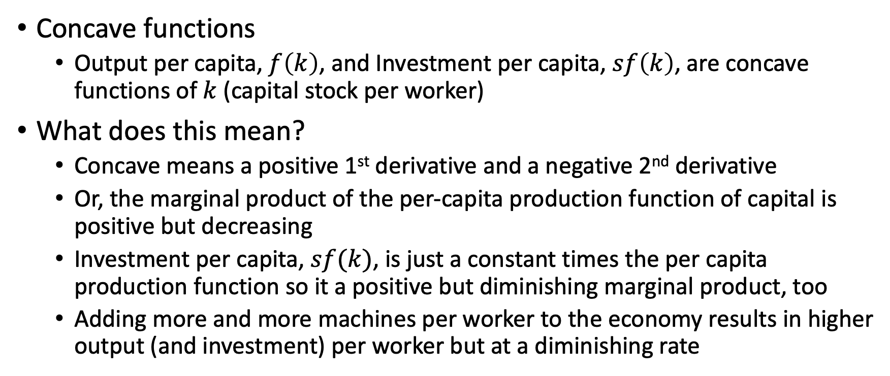
Mechanisms: Dynamics of Capital per Worker
Concave functions
Output per capita, $f\left(k\right)$, and Investment per capita, $sf\left(k\right)$, are concave functions of $k$ (capital stock per worker)
What does this mean?
Concave means a positive 1st derivative and a negative 2nd derivative
Or, the marginal product of the per-capita production function of capital is positive but decreasing
Investment per capita, $sf(k)$, is just a constant times the per capita production function so it a positive but diminishing marginal product, too
Adding more and more machines per worker to the economy results in higher output (and investment) per worker but at a diminishing rate

Slide 40
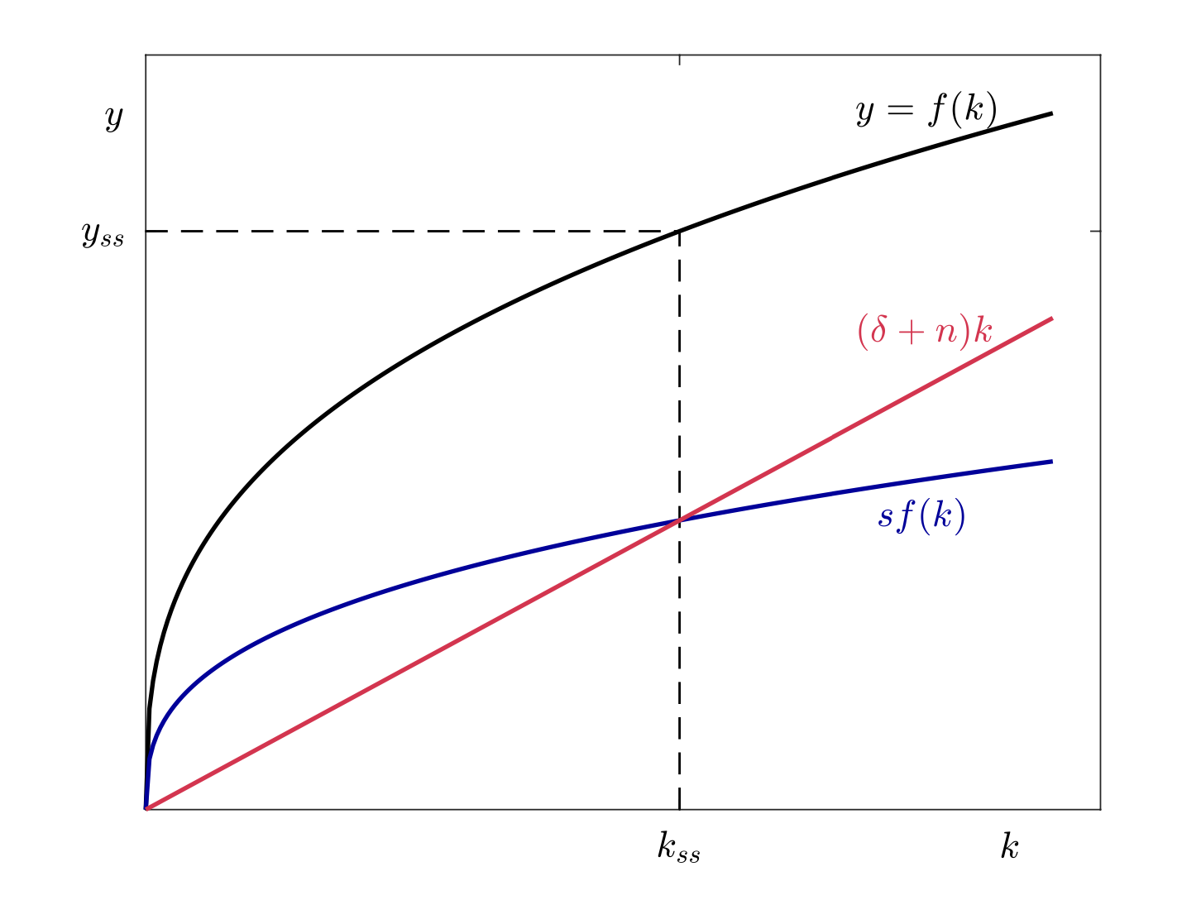
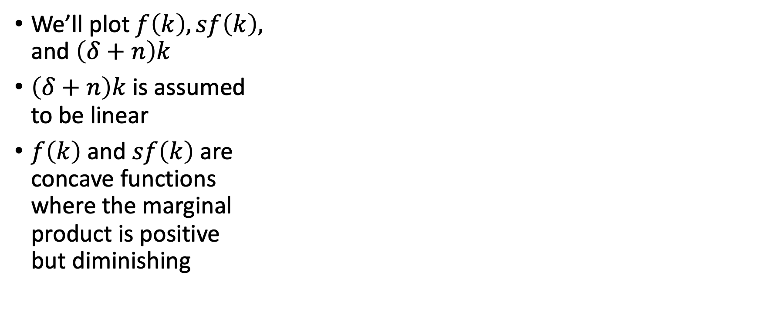
Mechanisms
We’ll plot $f\left(k\right), sf\left(k\right),$ and $\left(δ+n\right)k$
$\left(δ+n\right)k$ is assumed to be linear
$f\left(k\right)$ and $sf\left(k\right)$ are concave functions where the marginal product is positive but diminishing

Slide 41
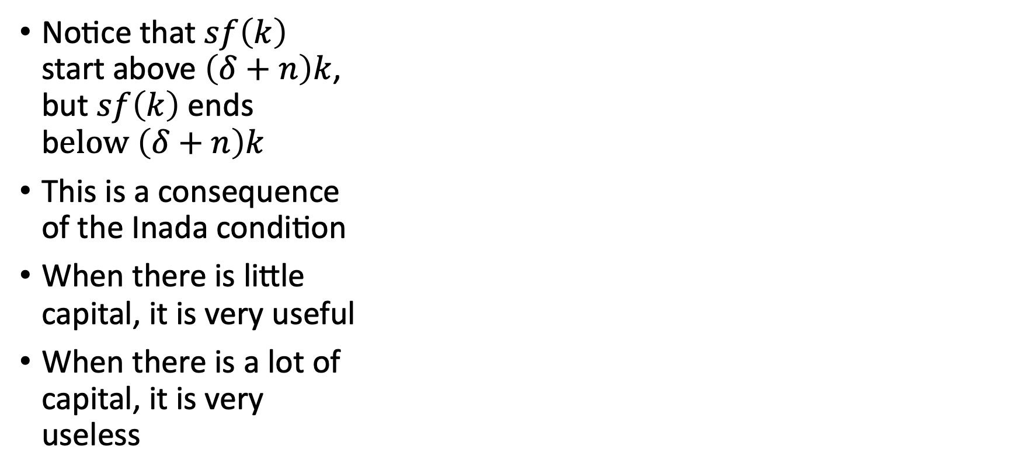
Mechanisms
Notice that $sf\left(k\right)$ start above $\left(δ+n\right)k$, but $sf\left(k\right)$ ends b$elow \left(δ+n\right)k$
This is a consequence of the Inada condition
When there is little capital, it is very useful
When there is a lot of capital, it is very useless

Slide 42
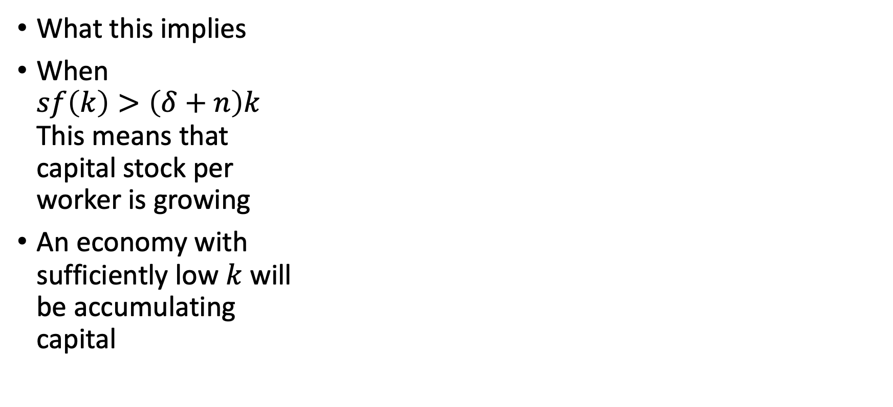
Mechanisms
What this implies
When $sf\left(k\right)>\left(δ+n\right)k$ This means that capital stock per worker is growing
An economy with sufficiently low $k$ will be accumulating capital

Slide 43
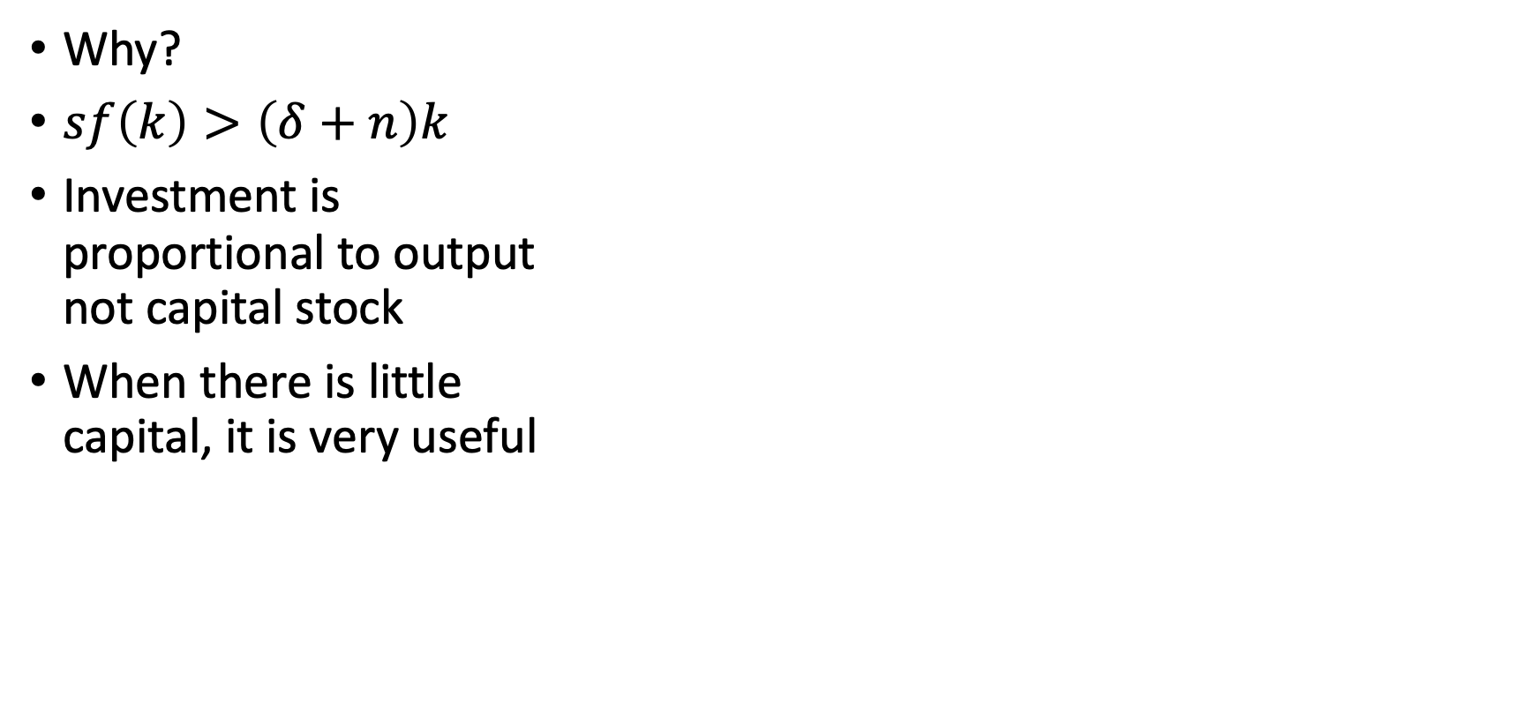
Mechanisms
Why?
$sf\left(k\right)>\left(δ+n\right)k$
Investment is proportional to output not capital stock
When there is little capital, it is very useful

Slide 44
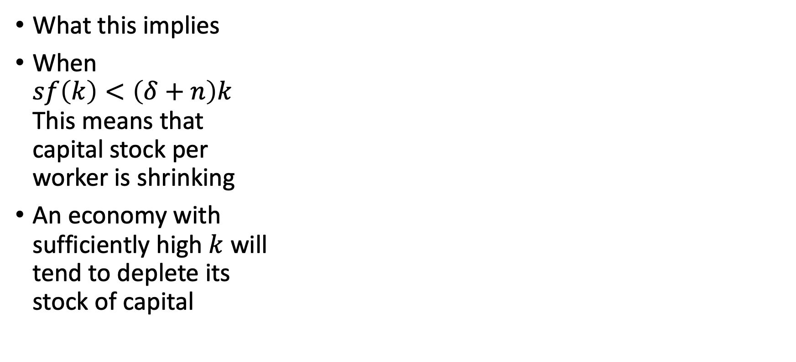
Mechanisms
What this implies
When $sf\left(k\right)<\left(δ+n\right)k$ This means that capital stock per worker is shrinking
An economy with sufficiently high $k$ will tend to deplete its stock of capital

Slide 45
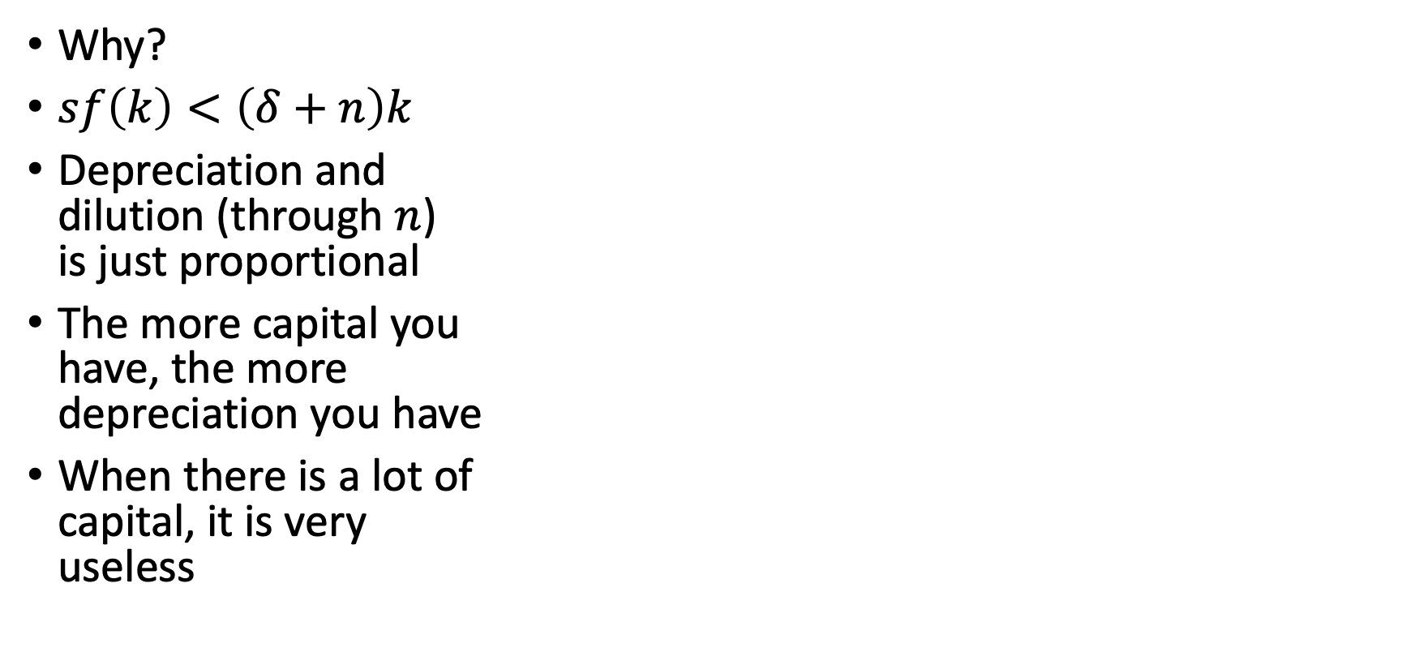
Mechanisms
Why?
$sf\left(k\right)<\left(δ+n\right)k$
Depreciation and dilution (through $n$) is just proportional
The more capital you have, the more depreciation you have
When there is a lot of capital, it is very useless

Slide 46
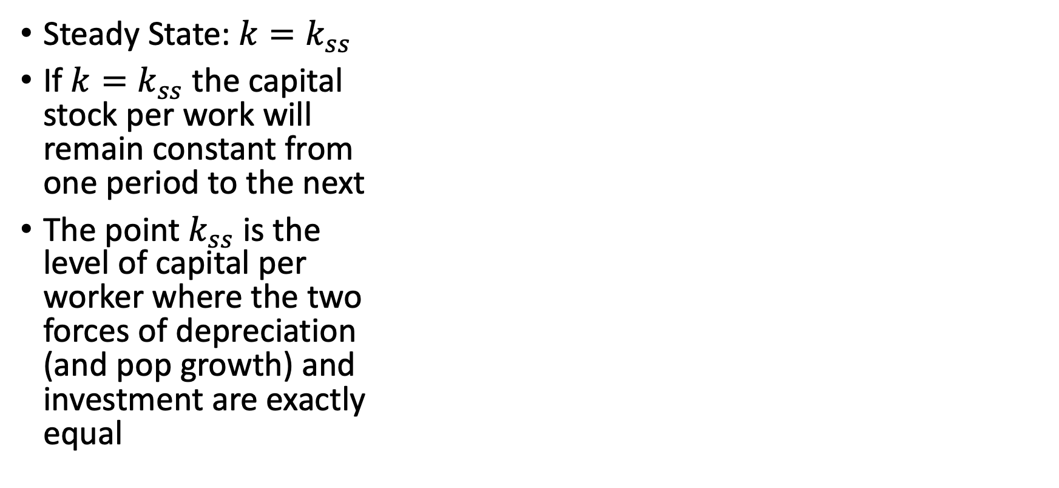
Mechanisms
Steady State: $k=k_{ss}$
If $k=k_{ss}$ the capital stock per work will remain constant from one period to the next
The point $k_{ss}$ is the level of capital per worker where the two forces of depreciation (and pop growth) and investment are exactly equal

Slide 47
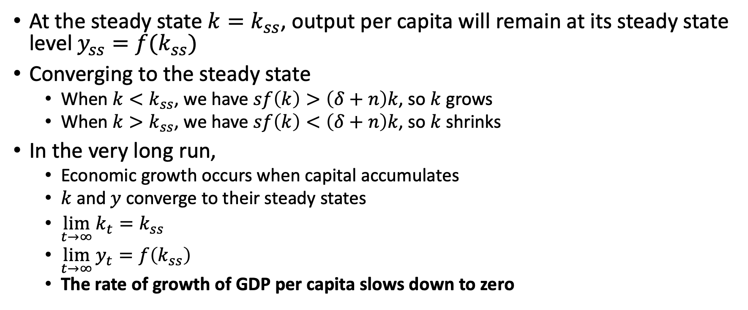
Mechanisms: Dynamics of Capital per Worker
At the steady state $k=k_{ss}$, output per capita will remain at its steady state level $y_{ss}=f(k_{ss})$
Converging to the steady state
When $k<k_{ss}$, we have $sf\left(k\right)>\left(δ+n\right)k$, so $k$ grows
When $k>k_{ss}$, we have $sf\left(k\right)<\left(δ+n\right)k$, so $k$ shrinks
In the very long run,
Economic growth occurs when capital accumulates
$k$ and $y$ converge to their steady states
$\lim_{t→∞}{k_{t}=k_{ss}}$
$\lim_{t→∞}{y_{t}=f\left(k_{ss}\right)}$
The rate of growth of GDP per capita slows down to zero

Slide 48
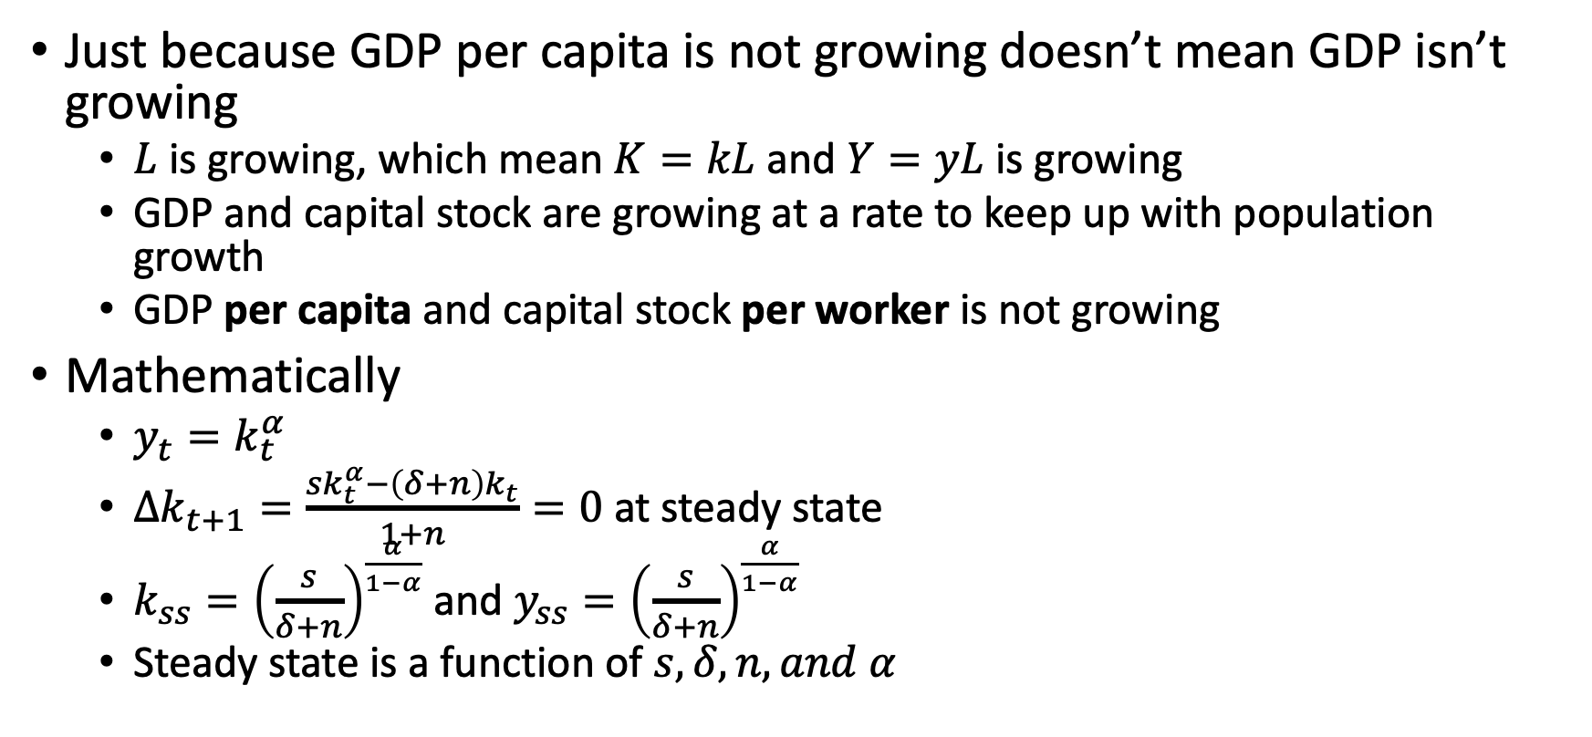
Mechanisms: Dynamics of Capital per Worker
Just because GDP per capita is not growing doesn’t mean GDP isn’t growing
$L$ is growing, which mean $K=kL$ and $Y=yL$ is growing
GDP and capital stock are growing at a rate to keep up with population growth
GDP per capita and capital stock per worker is not growing
Mathematically
$y_{t}=k_{t}^{α}$
$Δk_{t+1}=\frac{sk_{t}^{α}−\left(δ+n\right)k_{t}}{1+n}=0$ at steady state
$k_{ss}={\left(\frac{s}{δ+n}\right)}^{\frac{α}{1−α}}$ and $y_{ss}={\left(\frac{s}{δ+n}\right)}^{\frac{α}{1−α}}$
Steady state is a function of $s, δ, n, and α$

Slide 49
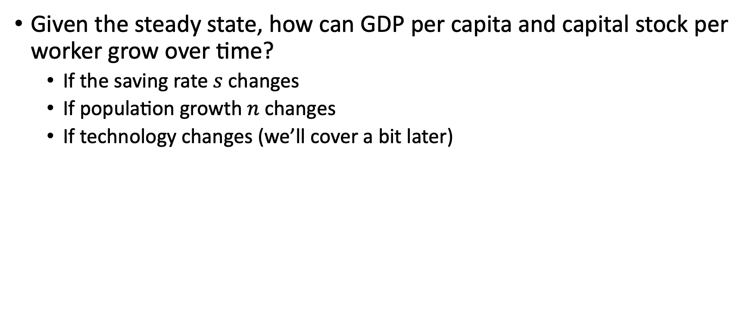
Mechanisms: Growth and Level Effects
Given the steady state, how can GDP per capita and capital stock per worker grow over time?
If the saving rate $s$ changes
If population growth $n$ changes
If technology changes (we’ll cover a bit later)

Slide 50
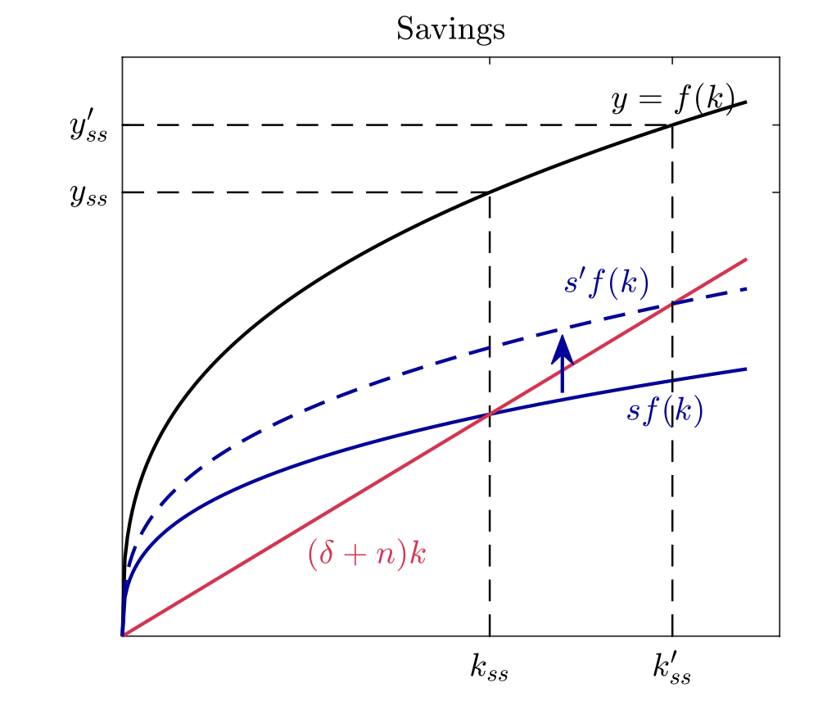
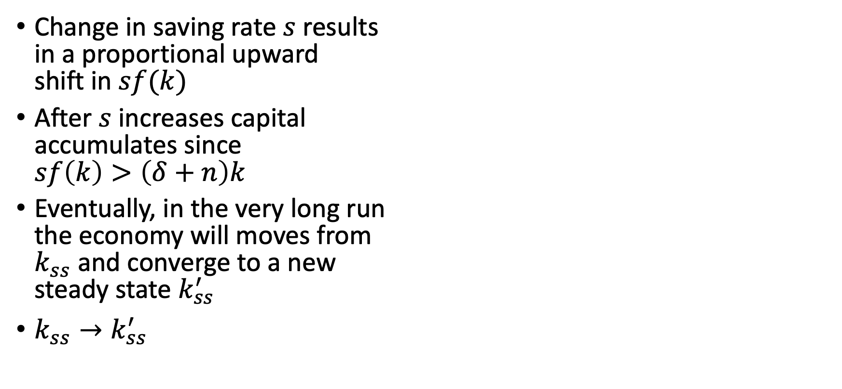
Mechanisms: Growth and Level Effects
Change in saving rate $s$ results in a proportional upward shift in $sf(k)$
After $s$ increases capital accumulates since $sf\left(k\right)>\left(δ+n\right)k$
Eventually, in the very long run the economy will moves from $k_{ss}$ and converge to a new steady state $k_{ss}^{′}$
$k_{ss}→k_{ss}^{′}$

Slide 51
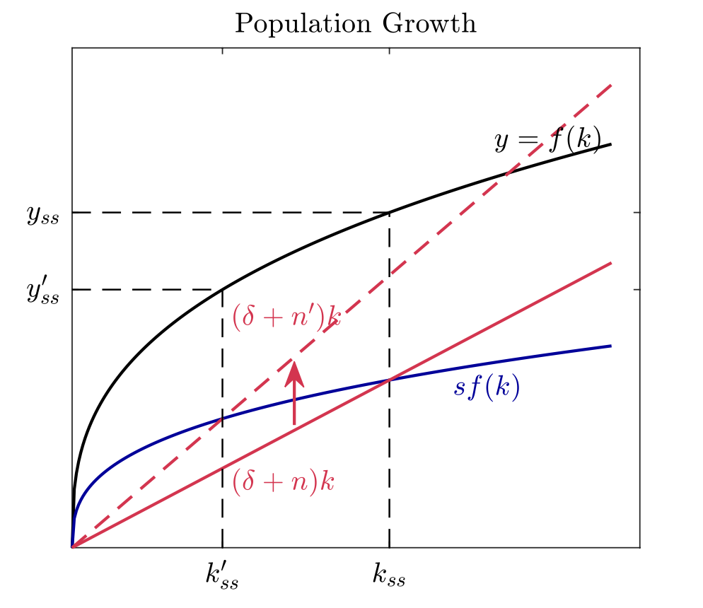
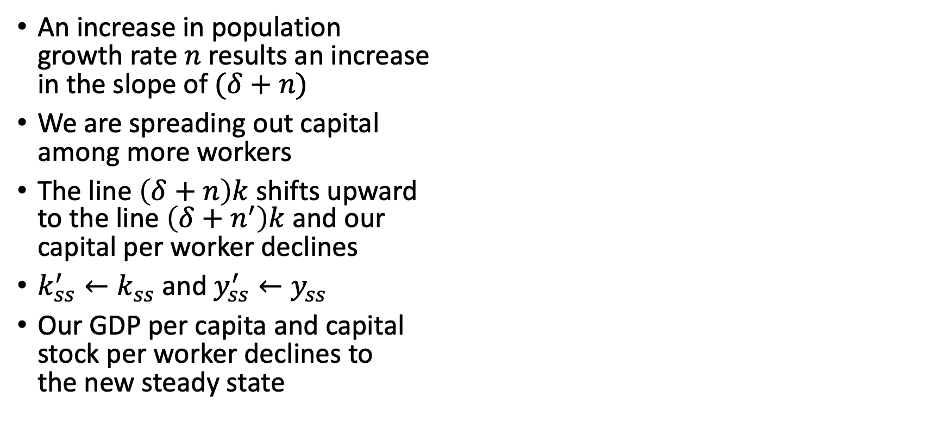
Mechanisms: Growth and Level Effects
An increase in population growth rate $n$ results an increase in the slope of $(δ+n)$
We are spreading out capital among more workers
The line $\left(δ+n\right)k$ shifts upward to the line $\left(δ+n^{′}\right)k$and our capital per worker declines
$k_{ss}^{′}←k_{ss}$ and $y_{ss}^{′}←y_{ss}$
Our GDP per capita and capital stock per worker declines to the new steady state

Slide 52
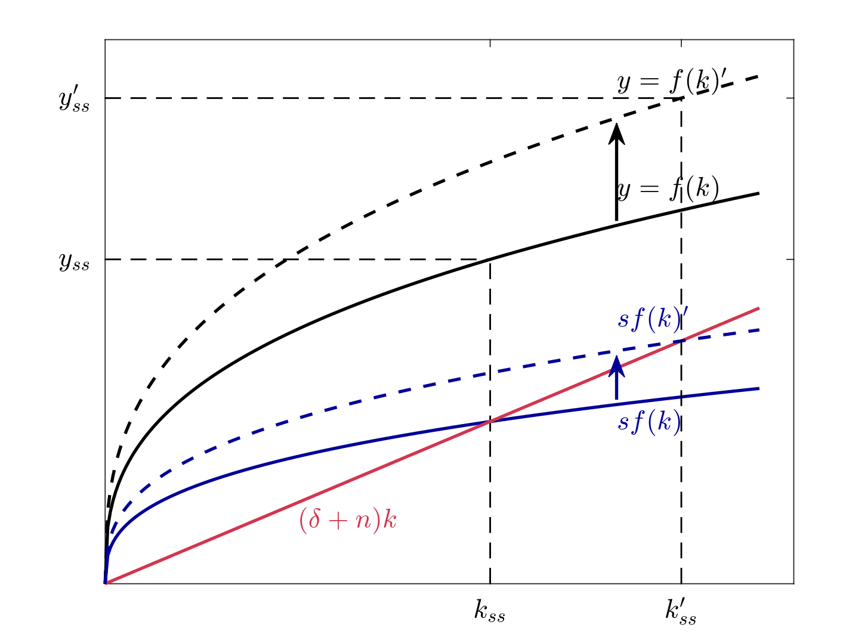
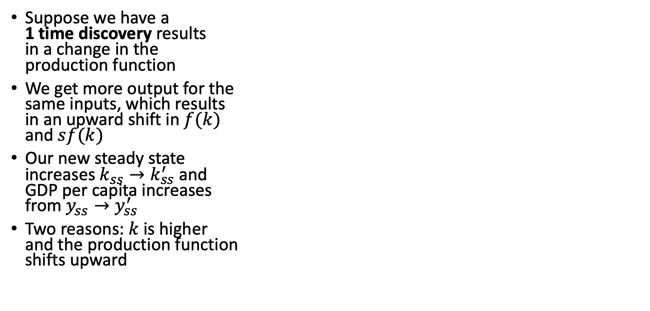
Mechanisms: Growth and Level Effects
Suppose we have a 1 time discovery results in a change in the production function
We get more output for the same inputs, which results in an upward shift in $f(k)$ and $sf(k)$
Our new steady state increases $k_{ss}→k_{ss}^{′}$ and GDP per capita increases from $y_{ss}→y_{ss}^{′}$
Two reasons: $k$ is higher and the production function shifts upward

Slide 53
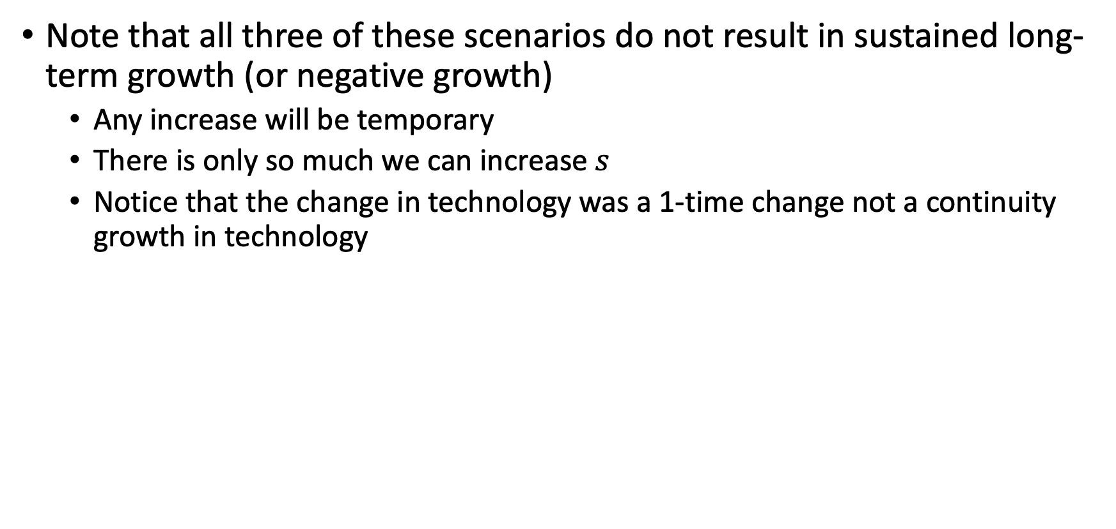
Mechanisms: Growth and Level Effects
Note that all three of these scenarios do not result in sustained long-term growth (or negative growth)
Any increase will be temporary
There is only so much we can increase $s$
Notice that the change in technology was a 1-time change not a continuity growth in technology

Slide 54
Solow Growth Model: The Golden Rule

Slide 55
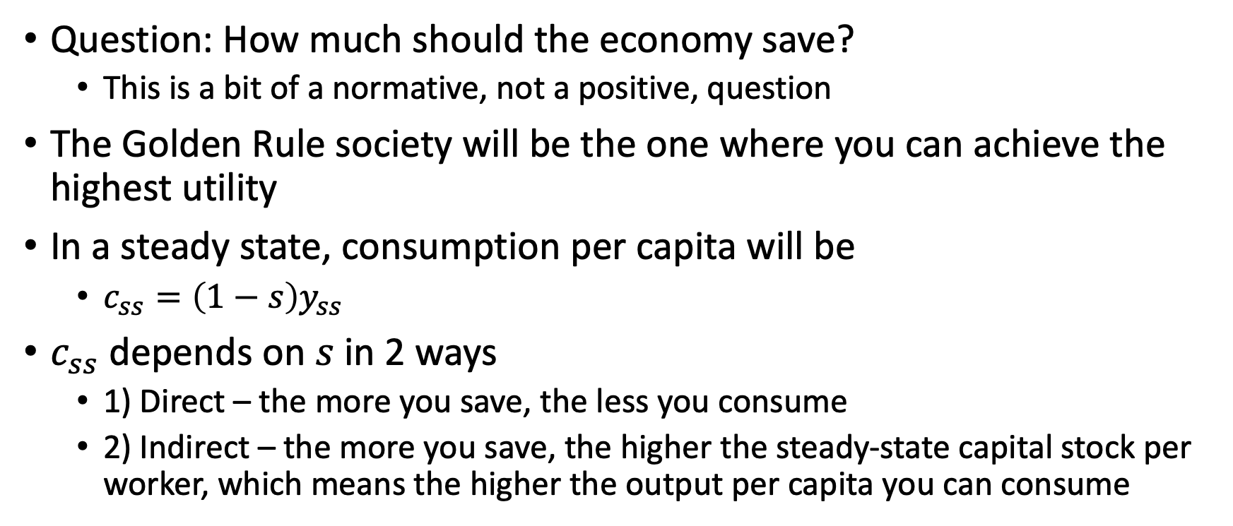
The Golden Rule
Question: How much should the economy save?
This is a bit of a normative, not a positive, question
The Golden Rule society will be the one where you can achieve the highest utility
In a steady state, consumption per capita will be
$c_{ss}=\left(1−s\right)y_{ss}$
$c_{ss}$ depends on $s$ in 2 ways
1) Direct – the more you save, the less you consume
2) Indirect – the more you save, the higher the steady-state capital stock per worker, which means the higher the output per capita you can consume

Slide 56
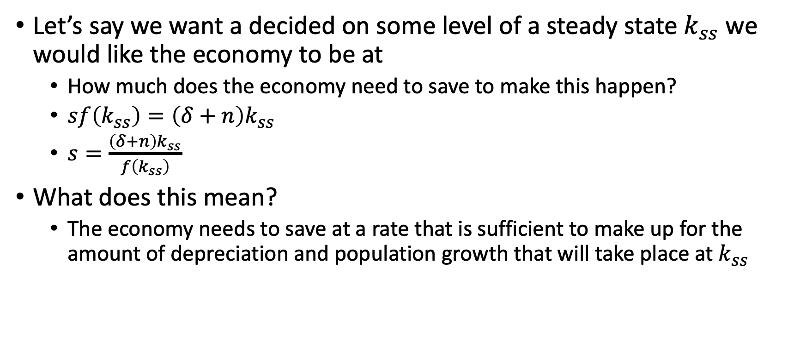
The Golden Rule
Let’s say we want a decided on some level of a steady state $k_{ss}$ we would like the economy to be at
How much does the economy need to save to make this happen?
$sf\left(k_{ss}\right)=\left(δ+n\right)k_{ss}$
$s=\frac{\left(δ+n\right)k_{ss}}{f\left(k_{ss}\right)}$
What does this mean?
The economy needs to save at a rate that is sufficient to make up for the amount of depreciation and population growth that will take place at $k_{ss}$

Slide 57
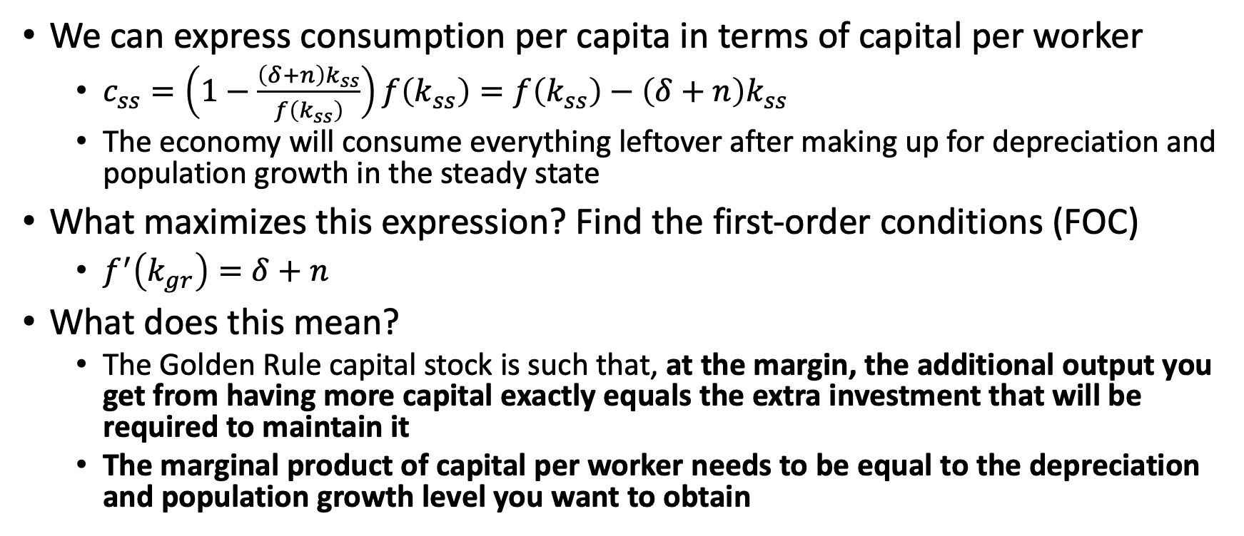
The Golden Rule
We can express consumption per capita in terms of capital per worker
$c_{ss}=\left(1−\frac{\left(δ+n\right)k_{ss}}{f\left(k_{ss}\right)}\right)f\left(k_{ss}\right)=f\left(k_{ss}\right)−\left(δ+n\right)k_{ss}$
The economy will consume everything leftover after making up for depreciation and population growth in the steady state
What maximizes this expression? Find the first-order conditions (FOC)
$f^{′}\left(k_{gr}\right)=δ+n$
What does this mean?
The Golden Rule capital stock is such that, at the margin, the additional output you get from having more capital exactly equals the extra investment that will be required to maintain it
The marginal product of capital per worker needs to be equal to the depreciation and population growth level you want to obtain

Slide 58
Solow Growth Model: Markets

Slide 59
Markets
How are factor inputs decided? When firms, workers, and capital interact in the market
Factor Markets
The Firm’s Decision
Market Clearing
Profits
Interest Rates
Response to Prices

Slide 60
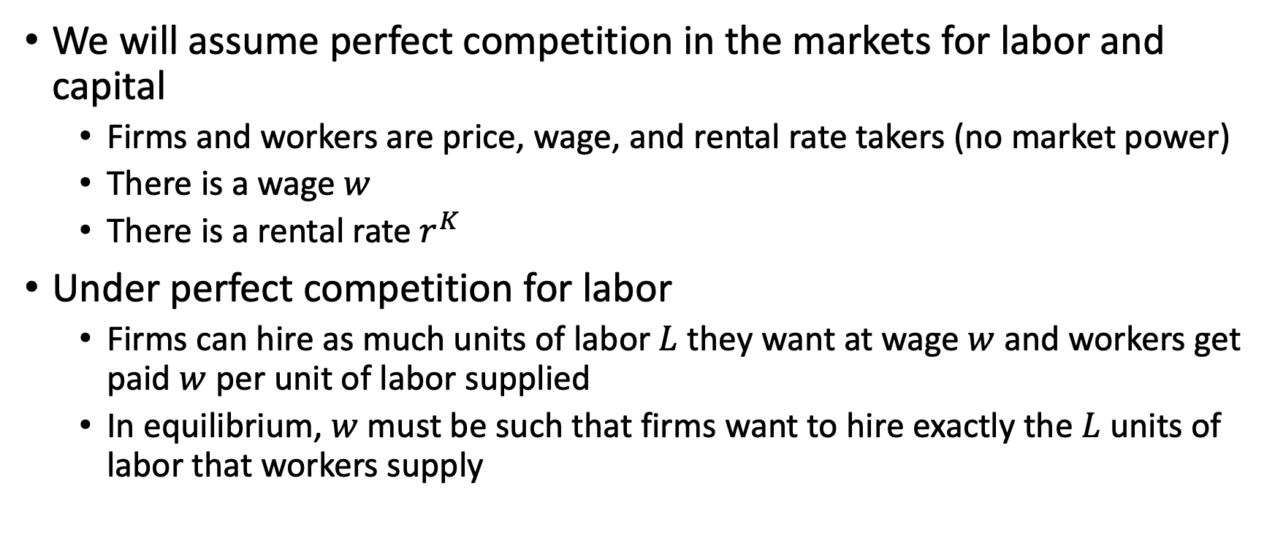
Markets: Factor Markets
We will assume perfect competition in the markets for labor and capital
Firms and workers are price, wage, and rental rate takers (no market power)
There is a wage $w$
There is a rental rate $r^{K}$
Under perfect competition for labor
Firms can hire as much units of labor $L$ they want at wage $w$ and workers get paid $w$ per unit of labor supplied
In equilibrium, $w$ must be such that firms want to hire exactly the $L$ units of labor that workers supply

Slide 61
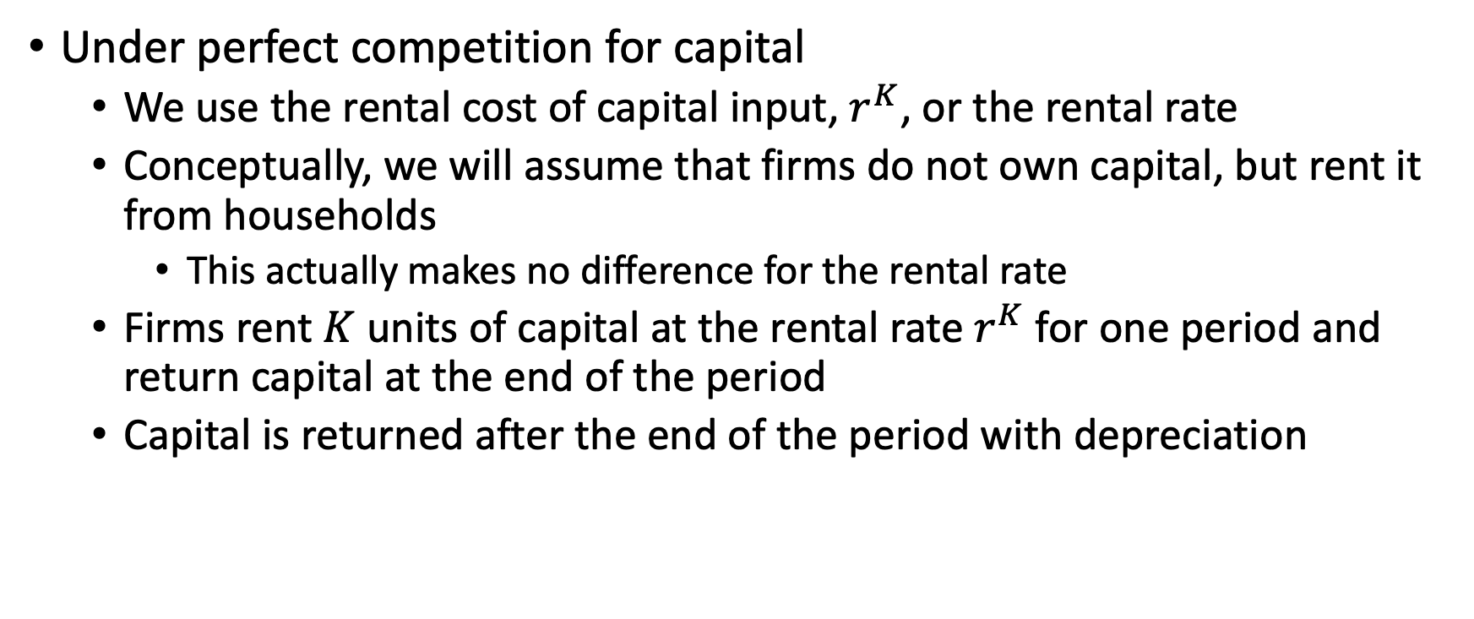
Markets: Factor Markets
Under perfect competition for capital
We use the rental cost of capital input, $r^{K}$, or the rental rate
Conceptually, we will assume that firms do not own capital, but rent it from households
This actually makes no difference for the rental rate
Firms rent $K$ units of capital at the rental rate $r^{K}$ for one period and return capital at the end of the period
Capital is returned after the end of the period with depreciation

Slide 62

Markets: The Firm’s Decision
For a single and homogenous good produced in the economy
Firm $i$ will demand $K_{i}$ and $L_{i}$
All firms have the same access to the same technology for $F(K,L)$
Profit Maximization
Firms will maximize economic profits in real terms with
$$\max_{K_{i},L_{i}}{F\left(K_{i},L_{i}\right)−wL_{i}−r^{K}K_{i}}$$
Where economic profits are equal to the output it produces less $wL_{i}$ for labor and $r^{K}K_{i}$ for capital (Note: we use need $p∗F\left(K_{i},L_{i}\right)$ in nominal terms)

Slide 63

Markets: The Firm’s Decision
First Order Conditions to maximize economic profits
$$\frac{∂F(K,L)}{∂K}=F_{K}\left(K_{i},L_{i}\right)−r^{K}=0$$
$$\frac{∂F(K,L)}{∂L}=F_{L}\left(K_{i},L_{i}\right)−w=0$$
Maximize economic profits when marginal product equal input price
$$MPK=F_{K}\left(K_{i},L_{i}\right)=r^{K}$$
$$MPL=F_{L}\left(K_{i},L_{i}\right)=w$$

Slide 64

Markets: The Firm’s Decision

Slide 65

Markets: The Firm’s Decision
Economic profits are maximized when $MPK=r^{K}$ and $MPL=w$ or when marginal products = marginal costs
If $F_{K}\left(K,L\right)−r^{K}>0$, then it would be profitable to hire more capital
If $F_{K}\left(K,L\right)−r^{K}<0$, then it would be profitable to reduce capital
If $F_{L}\left(K,L\right)−w>0$, then it would be profitable to hire more labor
If $F_{L}\left(K,L\right)−w<0$, then it would be profitable to reduce labor

Slide 66

Markets: Market Clearing
A few propositions
Proposition 4.1: Euler’s Theorem
$F_{K}\left(K,L\right)K+F_{L}\left(K,L\right)L=F(K,L)$
The production function satisfies
$F_{K}\left(λK,λL\right)=F_{K}\left(K,L\right) ∀ λ>0$
$F_{L}\left(λK,λL\right)=F_{L}\left(K,L\right) ∀ λ>0$
We’ll set $λ=\frac{1}{L_{i}}$ for $F_{K}\left(λK,λL\right)=F_{K}\left(K,L\right)$
We’ll set $λ=\frac{1}{K_{i}}$ for $F_{L}\left(λK,λL\right)=F_{L}\left(K,L\right)$

Slide 67

Markets: Market Clearing
Using our propositions and $λ=\frac{1}{L_{i}} and λ=\frac{1}{K_{i}}$
$F_{K}\left(K_{i},L_{i}\right)=F_{K}\left(λK_{i},λL_{i}\right)=F_{K}\left(\frac{K_{i}}{L_{i}},1\right)=F_{K}\left(\frac{K_{i}}{L_{i}}\right)$
And
$F_{L}\left(K_{i}, L_{i}\right)=F_{L}\left(λK_{i},λL_{i}\right)=F_{L}\left(1,\frac{L_{i}}{K_{i}}\right)=F_{L}\left(\frac{L_{i}}{K_{i}}\right)$
What does this mean?
The marginal product of capital depends up the ratio $\frac{K_{i}}{L_{i}}$
The marginal product of labor depends upon the ratio $\frac{L_{i}}{K_{i}}$

Slide 68

Markets: Market Clearing
Profit-maximizing firms will hire $K$ and $L$until the marginal product equals the factor prices, $w$ and $r^{K}$ and all firms hire $K_{i}=K$ and $L_{i}=L$
$r^{K}=F_{K}(K,L)$
$w=F_{L}(K,L)$
From Assumption 4.3: Diminishing Marginal Product
$r^{K}=F_{K}\left(\frac{K_{i}}{L_{i}}\right)=F_{K}(k)$
$w=F_{L}\left(\frac{L_{i}}{K_{i}}\right)=F_{L}\left(\frac{1}{k}\right)$
What does this mean?
High $k$: the marginal product of capital and the rental rate of capital will be low and wages will be high
Low $k$: the marginal product of capital will be high and so will the rental rate
Conversely, if there is a lot of capital, the marginal product of labor will be high and competition between firms will drive up wages

Slide 69

Markets: Profits
Economic profits are calculated as $F\left(K,L\right)−wL−r^{K}K$
Don’t forget that revenue is $p∗F(K,L)$
Proposition 4.2:
The representative firm will earn zero economic profits
$r^{K}K+wL=F\left(K,L\right)$ or $F\left(K,L\right)−F_{K}\left(K,L\right)K−F_{L}\left(K,L\right)L=0$
Since firms rent capital and hire labor, economic profits are 0
What does this mean?
Even though firms are trying to maximize economic profits, the maximum profit level that the firms can attain is zero in the very long run
Remember
Economic profits is conceptually different from accounting profits

Slide 70

Markets: Profits
Economic Profits vs Accounting Profits
A firm owns a retail space of a building and runs a clothes shop in the space
There is an opportunity cost for not renting out the retail space to another firm of $\$200,000$
The accounting profits are just implicit rental from capital that the firm owns
Note: we assume perfect competition and no risk
Income Statement (Accounting) |  | Income Statement (Economic)
Sales | $1,000,000 | Sales | $1,000,000
- Cost of Goods Sold | $500,000 | - Cost of Goods Sold | $500,000
- Expenses (Wages, No Mortgage) | $300,000 | = Value Added of Firm | $500,000
 |  | - Wages | $300,000
 |  | - Capital Rental | $200,000
= Profits | $200,000 | = Profits | $0

Slide 71

Markets: Interest Rates
There is a market for loans between two time periods along with labor and capital markets
A lender gives $x$ goods to the borrower in time $t$ and the borrow pays back $x\left(1+r_{t+1}\right)$ goods to the lender in period $t+1$
Where $r_{t+1}$ is the real interest rate on the loan
Note $r_{t+1}$ is real since it is in terms of goods not dollars

Slide 72

Markets: Interest Rates
Someone wants to save $x$ goods in period $t$. They can
Physical Investment
Convert goods into $x$ units of capital and rent them out
Where they get back in $t+1$
Rental Income: $r_{t+1}^{K}x$
Value of depreciated capital: $\left(1−δ\right)x$
For a total: $\left(1+r_{t+1}^{K}−δ\right)x$
Lending
They can lend $x$ goods
They get back $\left(1+r_{t+1}\right)x$ goods in $t+1$

Slide 73

Markets: Interest Rates
They will be indifferent between lending and physical investment if
$r_{t+1}=r_{t+1}^{K}−δ$
If $r_{t+1}<r_{t+1}^{K}−δ$
One could make an infinite gain by borrowing at rate $r_{t+1}$, investing in physical capital, which earns $r_{t+1}^{K}−δ$, pay back $r_{t+1}$ and keep the difference
But, no one would be willing to lend and the market won’t clear
If $r_{t+1}>r_{t+1}^{K}−δ$
Everyone would want to lend, but no want to borrow, so the market won’t clear
Interest rates will be high in economies where the marginal product of capital is higher (ceteris paribus)

Slide 74
Solow Growth Model: Technological Progress

Slide 75

Technological Progress
Technological progress is the key to sustained economic growth
We have assumed so far that there is no technological growth or that growth happens in 1-time increase not continual growth
Typically technological change is represented as $A$ in a production function:
$Y=A∗F\left(K,L\right)=AK^{α}L^{1−α}$
$lnY=lnAK^{α}L^{1−α}=lnA+αlnK+\left(1−α\right)lnL$
$lnA=lnY−αlnK−\left(1−α\right)lnL$
For this exercise, we will assume that technological progress is labor augmenting

Slide 76

Technological Progress
For this exercise, we will assume that technological progress is labor augmenting (which is a bit different than expected)
$Y=F(K,AL)$
$A$ represents the level of technology
$AL$ means that better technology is equivalent to having more workers with just $L$ worker
Assumption 4.9
The level of technology grows at a constant, exogenous rate $g$
$A_{t+1}=\left(1+g\right)A_{t}$

Slide 77

Technological Progress
We will restate our production function per capita terms with $AL$
${\tilde{k}}_{t}=\frac{K_{t}}{A_{t}L_{t}}$
${\tilde{y}}_{t}=\frac{Y_{t}}{A_{t}L_{t}}$
Production function per “efficiency unit of labor”
$\tilde{y}=\frac{F(K,AL)}{AL}=F\left(\frac{K}{AL},\frac{AL}{AL}\right)=F\left(\tilde{k},1\right)=f(\tilde{k})$

Slide 78

Technological Progress
We can see how capital per efficiency unit of labor evolves
$Δ{\tilde{k}}_{t+1}≡{\tilde{k}}_{t+1}−k_{t}=\frac{K_{t+1}}{A_{t+1}L_{t+1}}−{\tilde{k}}_{t}=\frac{\left(1−δ\right)K_{t}+I_{t}}{A_{t+1}L_{t+1}}−{\tilde{k}}_{t}$
$=$ $\frac{\left(1−δ\right)K_{t}+sY_{t}}{A_{t+1}L_{t+1}}∗\frac{(A_{t}L_{t})}{(A_{t}L_{t})}−{\tilde{k}}_{t}=\left[\frac{\left(1−δ\right)K_{t}+sY_{t}}{A_{t}L_{t}}\right]\left(\frac{A_{t}L_{t}}{A_{t+1}L_{t+1}}\right)−{\tilde{k}}_{t}$
$=\left[\left(1−δ\right){\tilde{k}}_{t}+s{\tilde{y}}_{t}\right]\left(\frac{A_{t}L_{t}}{\left(1+g\right)A_{t}\left(1+n\right)L_{t}}\right)−{\tilde{k}}_{t}$
$=\left[\left(1−δ\right){\tilde{k}}_{t}+s{\tilde{y}}_{t}\right]\left(\frac{1}{\left(1+n\right)\left(1+g\right)}\right)−{\tilde{k}}_{t}=\frac{\left(1−δ\right){\tilde{k}}_{t}+s{\tilde{y}}_{t}}{(1+n)(1+g)}−\frac{(1+n)(1+g){\tilde{k}}_{t}}{(1+n)(1+g)}$
$=\frac{s{\tilde{y}}_{t}−\left(δ+n+g\right){\tilde{k}}_{t}}{1+n+g+ng}≈\frac{s{\tilde{y}}_{t}−\left(δ+n+g\right){\tilde{k}}_{t}}{1+n+g+0}$
$=\frac{sf\left({\tilde{k}}_{t}\right)−\left(δ+n+g\right){\tilde{k}}_{t}}{1+n+g}$

Slide 79

Technological Progress
We reach a new steady state of “capital per efficiency units of labor”
$Δ{\tilde{k}}_{t+1}≡{\tilde{k}}_{t+1}−k_{t}=\frac{sf\left({\tilde{k}}_{t}\right)−\left(δ+n+g\right){\tilde{k}}_{t}}{1+n+g}$
$sf\left({\tilde{k}}_{ss}\right)=\left(δ+n+g\right){\tilde{k}}_{ss}$
Investment balances out depreciation, population growth, and technological progress
What does this mean?
Growth in $g$means we need to spread capital across more “efficiency units of labor”
Labor augmenting technological change dilutes “capital per efficiency unit of labor”
Since $g$ only impacts $A_{t}L_{t}$, it increases efficiency units of labor similar to $n$
Does this mean technological changes doesn’t matter?

Slide 80

Technological Progress
Let’s see what happens at the steady state on a per capita basis?
At the steady state for “efficiency units of labor”
${\tilde{y}}_{t}={\tilde{y}}_{t+1}$
$\frac{Y_{t}}{A_{t}L_{t}}=\frac{Y_{t+1} }{A_{t+1}L_{t+1}} ⇒ \frac{y_{t}}{A_{t}}=\frac{y_{t+1}}{A_{t+1}} ⇒ \frac{A_{t+1}}{A_{t}}=\frac{y_{t+1}}{y_{t}}$
$$\frac{y_{t+1}}{y_{t}}=\left(1+g\right)$$
What does this mean?
While $\tilde{y}$ is at a steady state, $y$ is growing!
Proposition 4.3: In the steady state
GDP per capita grows at the rate of technological progress
Capital per worker grows at the rate of technological progress
The ratio of $\frac{K}{Y}$ is constant

Slide 81
Concluding Remarks
In the very long run, GDP per capita converges to a steady state
Technology change (productivity growth) is the key to sustainable, long-term economic growth
Note: some assumptions from the model are not realistic:
Population growth may be slowing down
Labor share has declined
Depreciation will vary by type of capital
There may be barriers to entry
We may not have constant returns to scale
Not everyone is in the labor force
Even without these assumption: productivity growth is key

